Slide 1
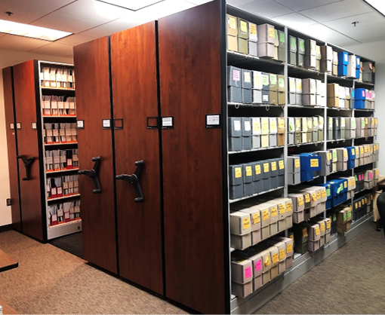
Session 4: OSA Data Management & Access
Updates and Next steps

Slide 2
What we’ve done 2017-Present
Improvements to in-person background research process
Organization and digitization of archival records
90% of archaeological reports scanned
60% of archaeological site forms scanned
Created custom tools to identify and export sites and surveys
Worked with DIT to update kiosks
Digitized archaeological sites and surveys into GIS
Streamlined internal environmental review process
ArcGIS Online (AGOL) web maps for OSA Environmental Review Staff
Site Form Access Database -> Laserfiche database
Migrated data from Access database, scanned forms
New process for site forms
Created a new site form in Laserfiche

Slide 3
What we aim to do
Looking ahead, our goals include:
Survey Report database updates
Remote access to GIS data
Remote access to Site Files and Reports

Slide 4
General Statutes
§ 12-3.1. states that only the General Assembly has the power to authorize an agency to establish or increase a fee or charge for rendering any service or fulfilling any duty to the public, with the following exceptions:
(c) Exceptions. – This section does not apply to any of the following:
(1) Rules establishing fees or charges to State, federal or local governmental units.
(2) A reasonable fee or charge for copying, transcripts of public hearings, State publications, or mailing a document or other item.
(3) Reasonable registration fees covering the cost of a conference or workshop.
(4) Reasonable user fees covering the cost of providing data processing services.
§ 150B-19. Restrictions on what can be adopted as a rule.
An agency may not adopt a rule that does one or more of the following:
(5) Establishes a fee or other charge for providing a service in fulfillment of a duty unless a law specifically authorizes the agency to do so or the fee or other charge is for one of the following:
a. A service to a State, federal, or local governmental unit.
b. A copy of part or all of a State publication or other document, the cost of mailing a document, or both.
c. A transcript of a public hearing.
d. A conference, workshop, or course.
e. Data processing services.

Slide 5
Remote Access and License Costs
~70 consultant firms (more than 300 resumes on file)
License cost > $10,000 /year
Administrative code change to a fee schedule for account access
DNCR Legal review and approval of contract templates
Account creation for collected fees and license payments

Slide 6
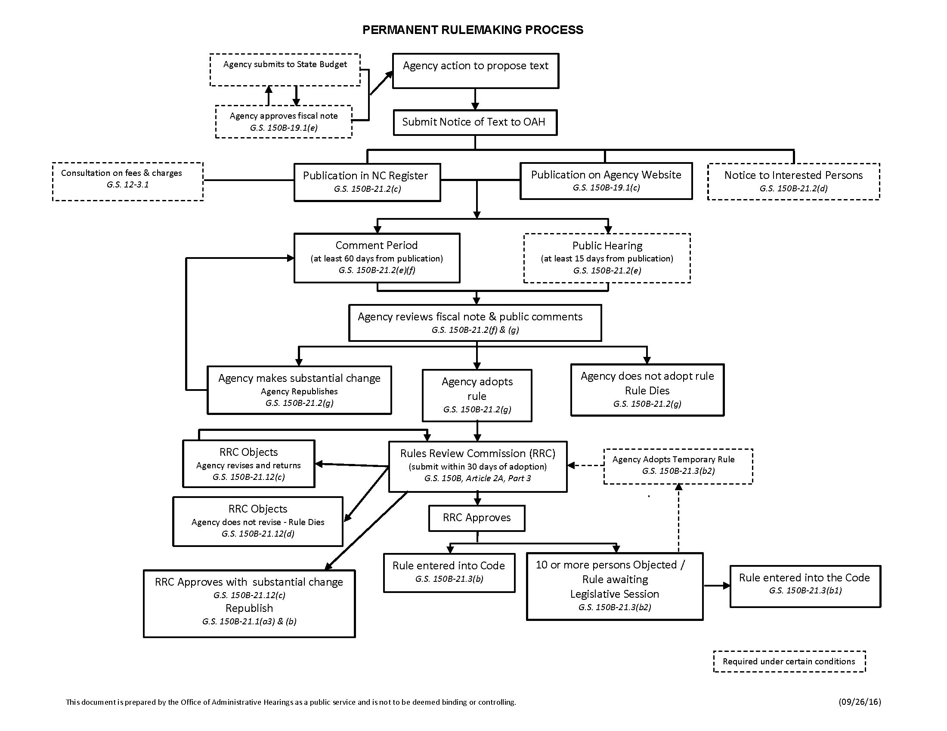
Administrative Code Change
Prior to 2013, North Carolina’s Administrative Procedure Act did not have expiration dates for rules.
G.S. 150B-21.3A requires that all rules adopted under G.S. 150B, Article 2A, be reviewed every 10 years by the agency that promulgated the rules to ensure rules are necessary and within the agency’s statutory authority.

Slide 7
What we’re doing now...
Groundwork for remote (external) access
Administrative Code updates
Data sharing policy updates
Moving from ArcMap to AGOL
New GIS tools in development
Continuing to work with DIT on kiosk performance issues

Slide 8
Questions
Dylan J. Clark, Ph.D., RPA Deputy State Archaeologist (Land)
Office of State Archaeology
828-250-3109 dylan.clark@dncr.nc.gov
Sam Franklin
GIS Specialist
Office of State Archaeology
919-814-6563
samuel.franklin@dncr.nc.gov

