Slide 1
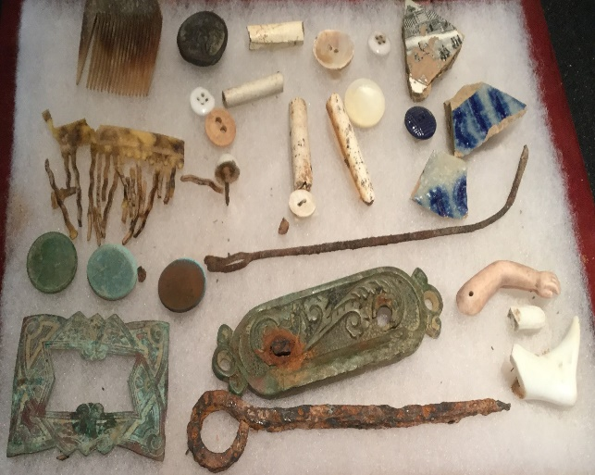
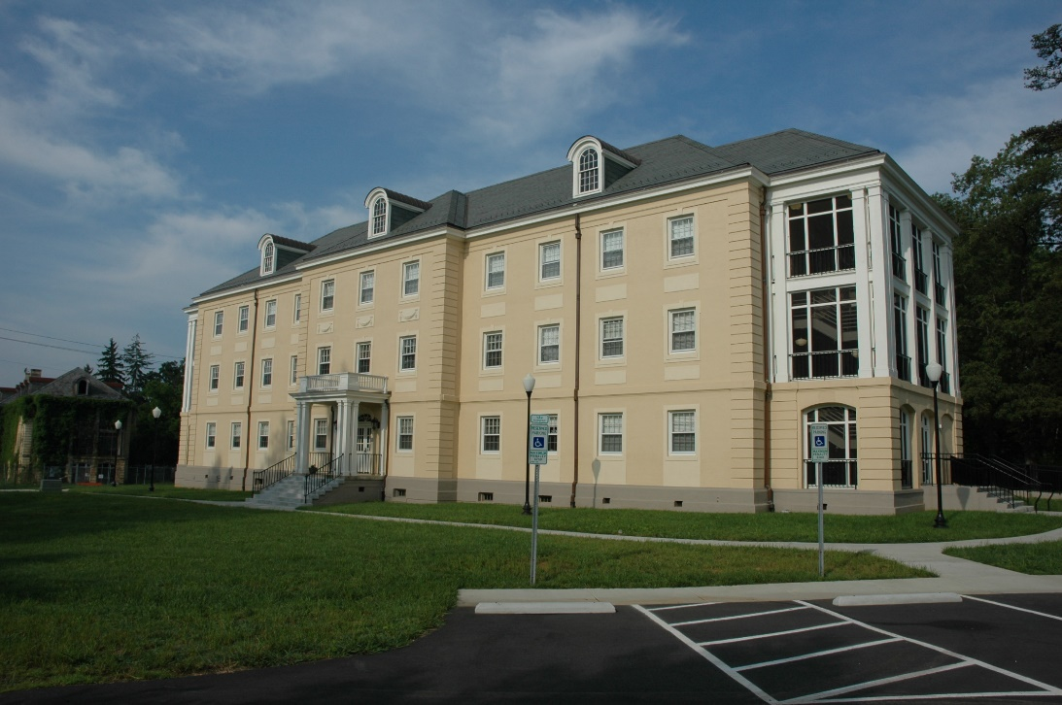
Session 3: OSA
Standards & Guidelines
Site Number Registration
ER Submission Deliverables
DNCR Western Office Asheville, NC

Slide 2
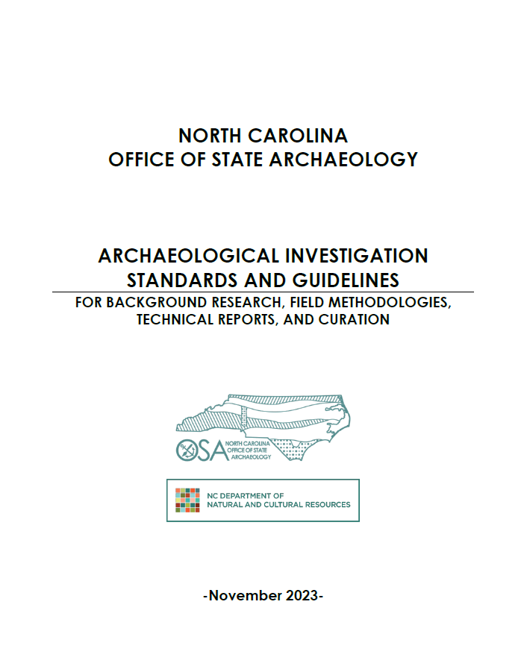
OSA Archaeological Investigations Standards and Guidelines November 2023 Revisions
Archaeological background summaries within two miles
GPR and remote sensing
Lays out clear data recovery and reporting standards for cemetery surveys
Not addressed in 2023 revisions
Large acreage reconnaissance survey: >250 ac.
Designed to provide reviewers with more information on a project area
Systematic ped survey and judgmental shovel testing
All sites identified at recon stage should be delineated and evaluated during Phase I

Slide 3
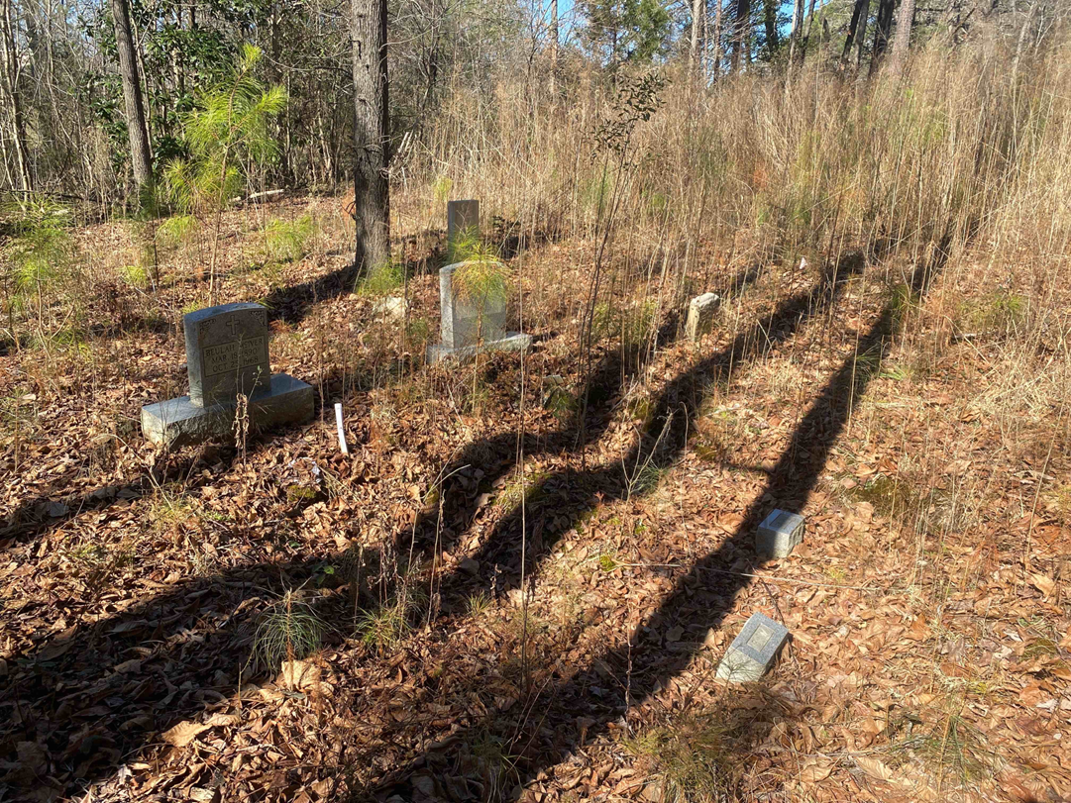
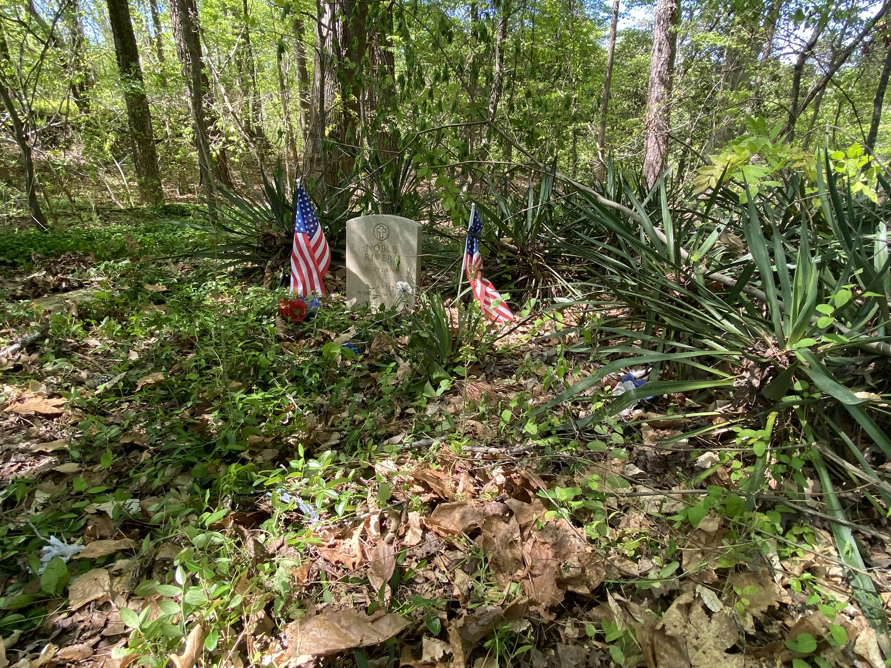
Cemetery Delineations and Surveys
Delineation before recommendation of avoidance measures. Survey should include:
Pedestrian Survey
Bidirectional pedestrian survey at 2 meter transect intervals within an initially proposed 10-meter buffer as defined by initial visual observation and supported by photographs (minimum of 5 transects).
Ground Penetrating Radar- whenever field conditions allow for it.
Clearing the survey area of vegetation and brush, avoid damaging grave markers or disturbing any shrubbery, flowers, plants, or other articles planted or placed within the cemetery to designate where human remains have been interred
Radar data in cemeteries should be collected along transects perpendicular to grave orientation spaced no more than 50 cm apart (25 cm spacing recommended). Radar antennas with central frequency ranges from 200-700 MHz are recommended.
Other remote sensing techniques, such as magnetometer, electrical resistivity, and electromagnetic conductivity (EM) may provide complementary or even better results
Soil Probing and augering- especially when GPR is not feasible or practical
Soil sampling tubes or augers can also be used and may provide greater information about soil disturbances than probing alone.
Recommendations for appropriate methods for probing surveys include:
Establish site datum and record survey grid boundaries with GPS points.
Systematic probing transects should be spaced no more than 2-4 feet apart and extend a minimum of 10 meters beyond the last recognizable grave marker or depression.
Record the locations of any positive probing “hits” and provide a map showing probing transects and the locations of all positive locations.

Slide 4
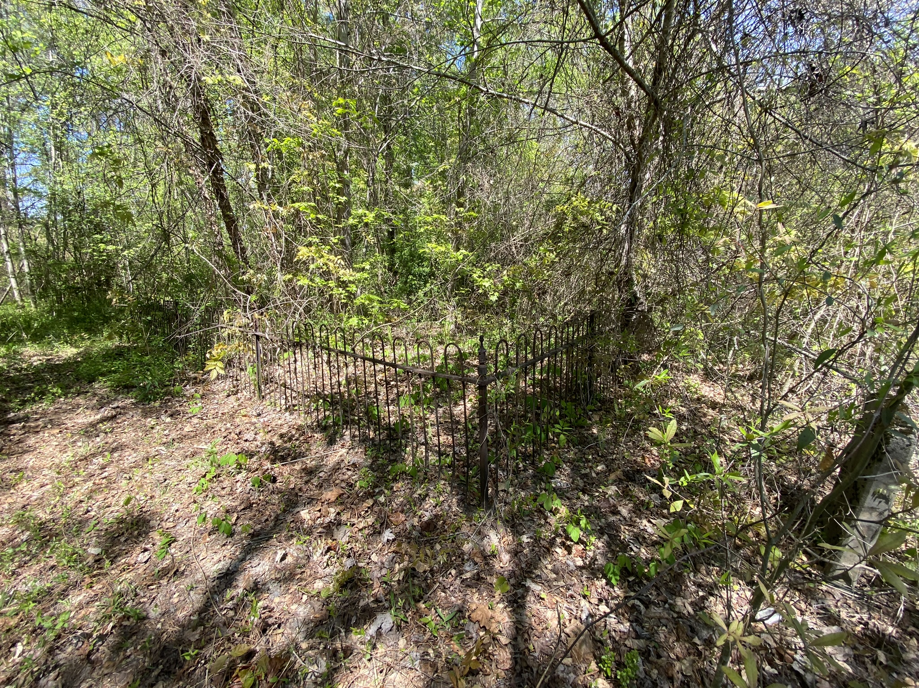
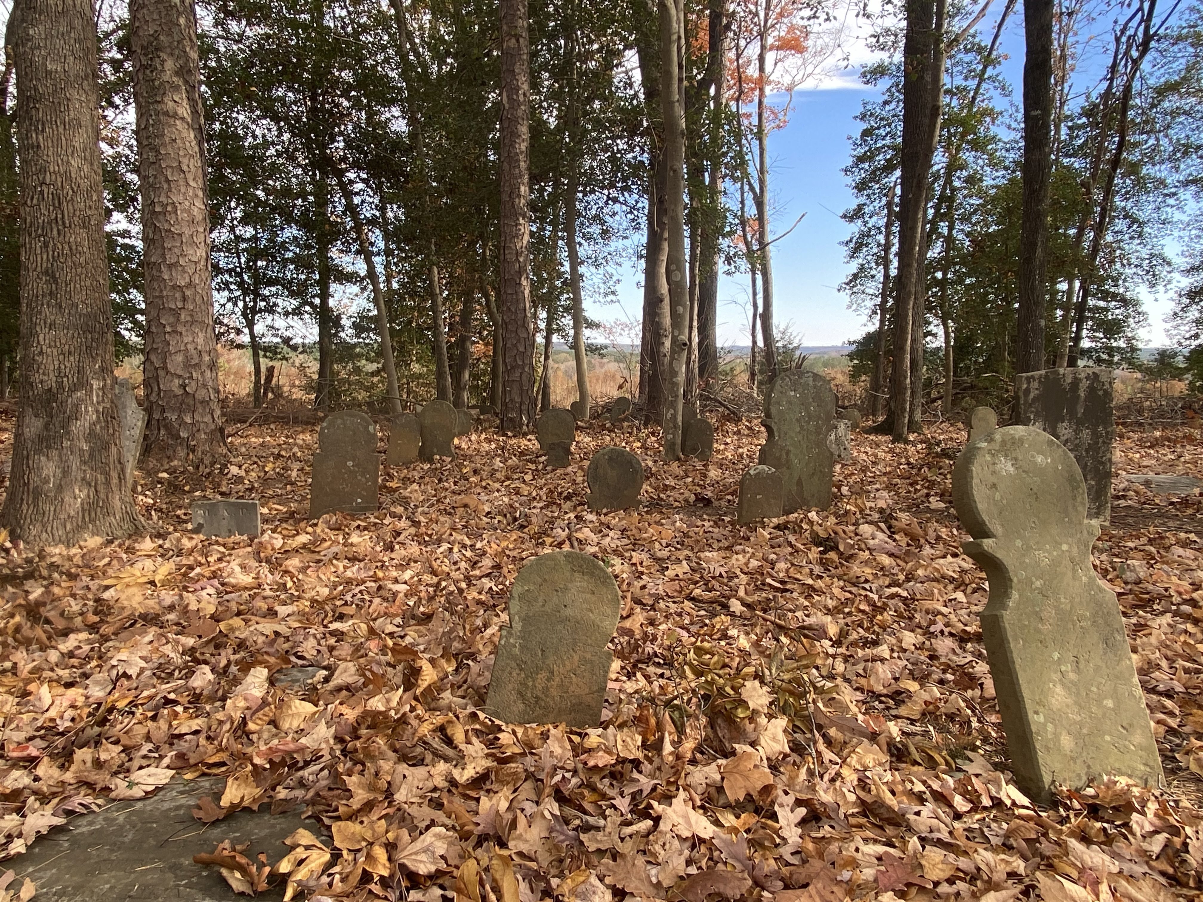
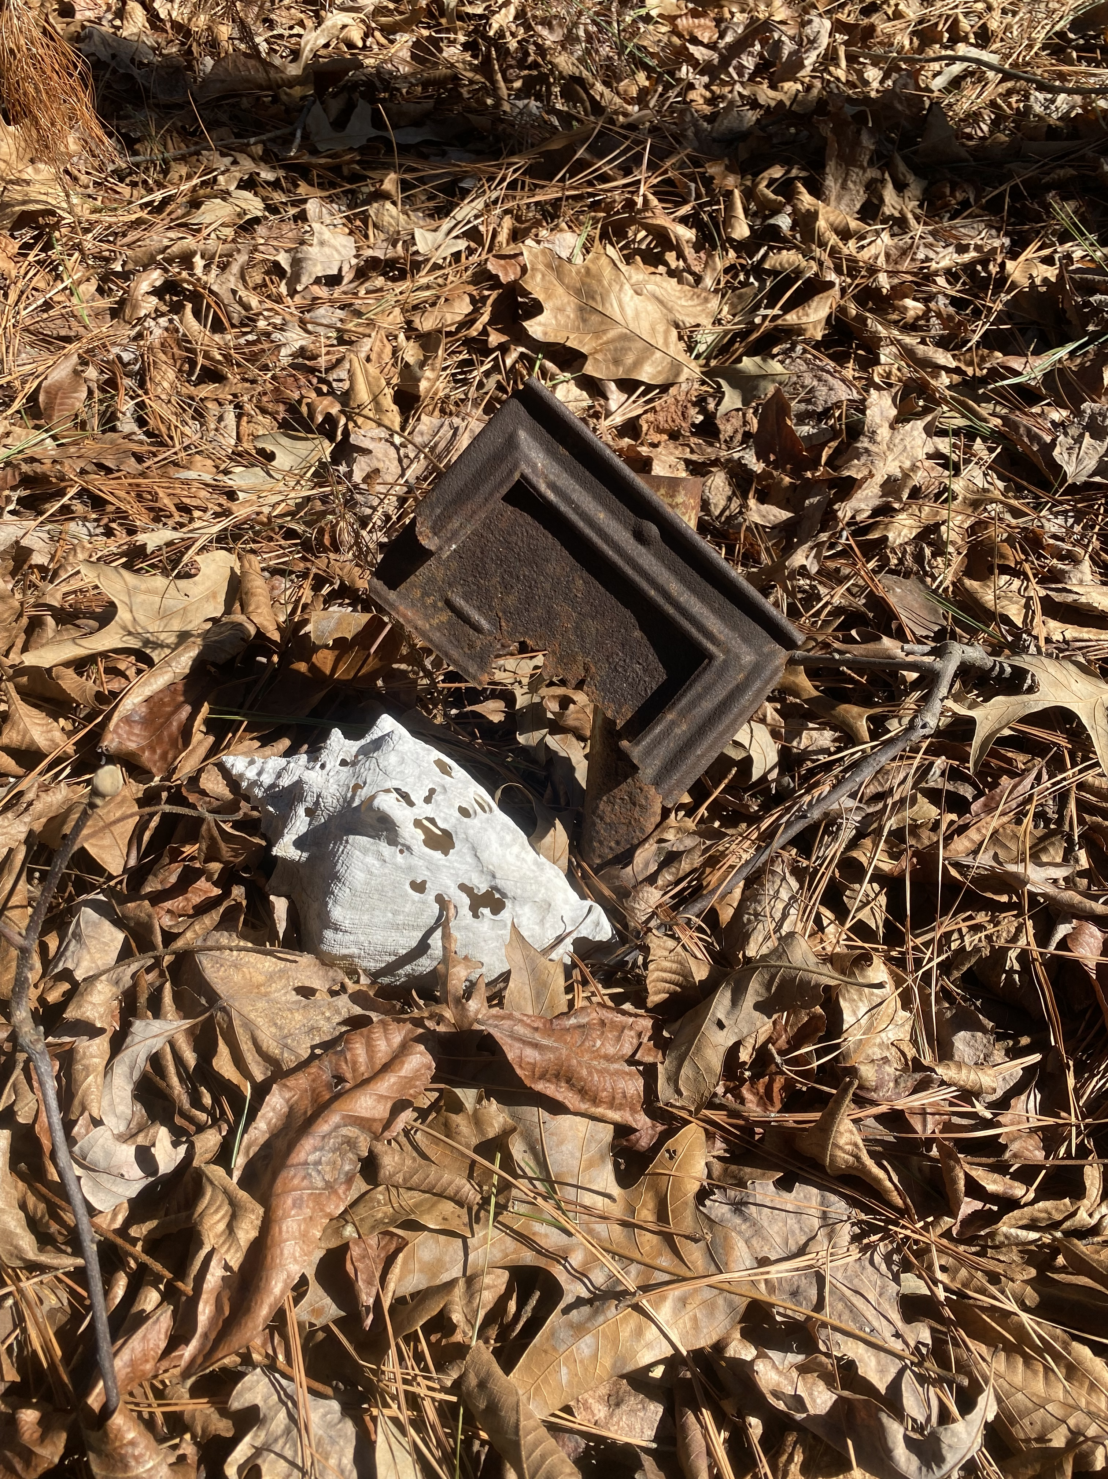
Cemetery Protection/Avoidance
Once delineated, an appropriate buffer should be determined in consultation with the OSA.
If the cemetery is on private property, the final buffered cemetery boundary should be mapped by a licensed surveyor, recorded on deeds or plats, and filed with the appropriate county to ensure that the county and any future landowners are aware of its presence.
High-visibility construction fencing during construction activities may be recommended near cemeteries that do not have a fence or other physical barrier. If a permanent fence will be added, it should have a gate for accessibility.
While buffer recommendations may vary depending on a variety of factors, the OSA offers the following general guidance:
10-meter (32.8 feet) Buffer
Modern (mid-20th-century and later) cemeteries.
Fenced cemeteries unless determined to, or thought to have potential to, be associated with an enslaved community.
All cemeteries that have been delineated with Ground Penetrating Radar (assuming the GPR survey was done by a professional archaeologist using approved methodologies) or other type of recommended cemetery delineation method where GPR is not feasible (e.g., probing).
15-meter (49.2 feet) Buffer
Older, post-emancipation family cemeteries.
Older, post-emancipation community cemeteries.
Older, pre-emancipation cemeteries that research has shown to have a low potential to be associated with an enslaved community.
30-meter (98.4 feet) Buffer
Older, pre-emancipation cemeteries determined to, or thought to have potential to, be associated with an enslaved community that have not been delineated with GPR or other recommended cemetery delineation method where GPR is not feasible (e.g., probing).

Slide 5
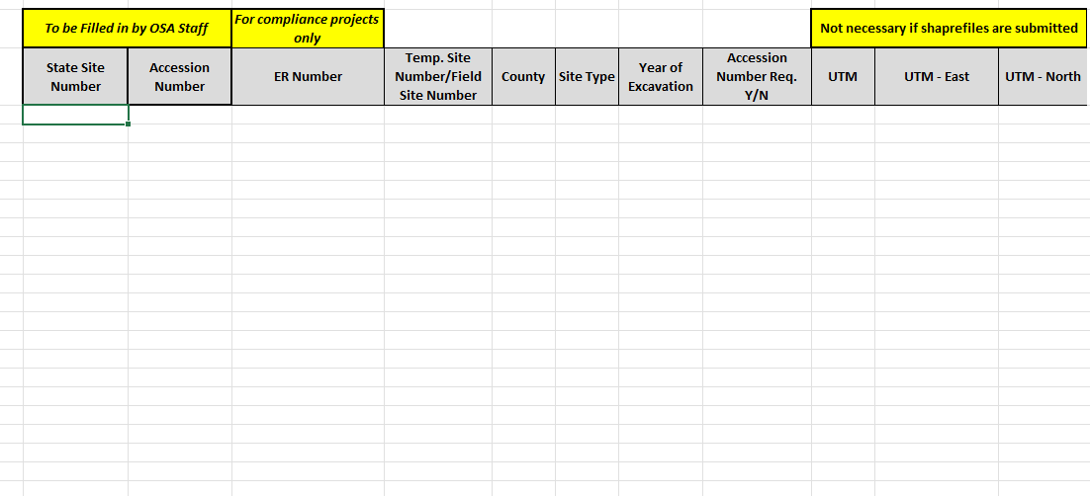
Requesting Site and Accession Numbers
To request site and/or accession numbers, email site.numbers@dncr.nc.gov
Completed site number request table with the following information:
Project or Temporary site number for each site
Project tracking number (ER, GS, CT, PA, etc.) if applicable
County the site is located in
Site type (i.e. Prehistoric, historic, or both)
Whether you would like an accession number for each site
The year the excavation took place (accession numbers are assigned based on year of excavation)
If shapefile not submitted, UTM coordinates for sites required
Shapefile of sites recommended/preferred
A KML file will also work
A map/maps with site locations clearly labeled
More detailed instructions can be found here:
https://archaeology.ncdcr.gov/about/forms#sitenumbers
Notes:
To request State Site Numbers and/or Accession numbers you will need to submit a request by emailing site.numbers@dncr.nc.gov. In your submission you need to include the following:
A Completed site number request table which can be found on our website with the following information filled out
Project or Temporary site number for each site, sometimes called field site numbers
Project tracking number like an ER number if you have one
The county the site is located in
The Site type, this is either Prehistoric, Historic, or Both
If you plan to curate the artifacts with OSARC, you need to request an accession number
The year the excavation took place. Our accession numbers are assigned based on the year of excavation
We recommend and prefer that you submit a shapefile for your site locations as this gives us the most accurate site boundaries.
A KML file will also work but is not preferred
If you do not submit a shapefile or a KML file then you will need to complete the UTM coordinates section of the site number request table.
Please also submit a map or maps of the sites with site locations clearly labeled using your temporary site numbers
More detailed instructions for submitting site and accession number requests as well as submitting GIS data along with a download of the site number request table can be found on our website.

Slide 6
Site and Accession Numbers: What comes next?
A record of the site registration and accession number assignment is made in tracking and our accession logs respectively
The sites are mapped out onto our statewide GIS map
You will receive an email back with the site number request table attached and completed with your state trinomials and the accession numbers if requested
Notes:
Once a request has been made we will go through the process of registering your sites into our records. We assign a site number and an accession number if requested and map the site onto our Statewide GIS map. In 3-5 business days you can expect to receive an email back with the site number request table reattached and completed with your state site trinomials and accession numbers.

Slide 7
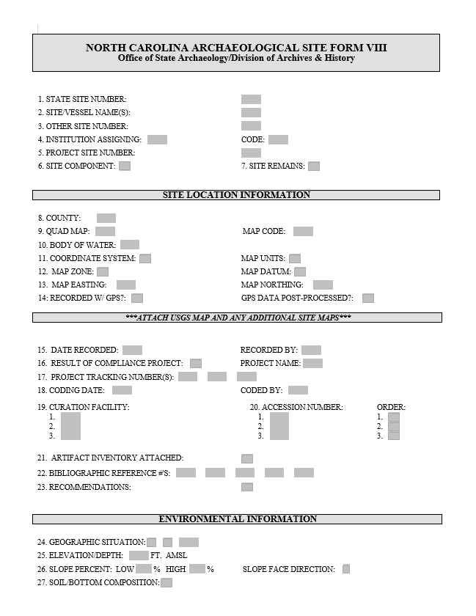
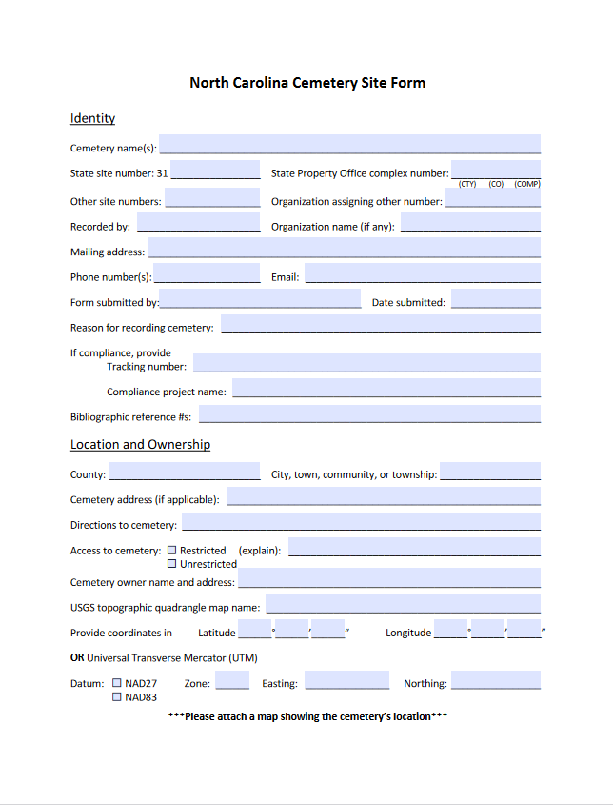
OSA Standards and Guidelines and Forms Available for download on our website archaeology.ncdcr.gov
Notes:
If the OSA does recommend an archaeological survey for a project, we provide guidelines on our website for what the appropriate field methodology should be, down to the shovel test transect spacing, and we also lay out what we expect to see in all reports so that we are able to comment on the site assessment recommendations that are being made.
We lay out what we expect to see in different report types, from survey reports to data recovery projects.
For data recoveries, reporting is so important because archaeology as a science is destructive by nature. When you excavate a site, you are destroying it, so without that documentation as to what was found, and in what context and association, and what was learned, then the archaeological excavation is arguable meaningless.
Also included in our guidelines are the site and cemetery forms that must be submitted with reports if a site and/or cemetery is identified
We also include information on our curation standards and how to curate collections with us.

Slide 8
Required Archaeology Deliverables
Digital Documents to be submitted through ShareFile
One (1) digital copy of the archaeology survey report as a PDF
Do NOT include site forms as appendices to reports
One (1) digital copy of each NC Site Form for each new site identified and/or each site revisited
A map of each site must be included with each form
Physical Documents to be mailed
One (1) hard copy of the archaeology survey report will be requested by OSA after the digital version is reviewed and accepted.
Address will be included on hard copy request letter
Notes:
Key take away: Submit digital documents to sharefile. Only 1 digital copy of the report, 1 hard copy, and 1 copy of EACH site form with an attached map are needed. Do not send in hard copies until requested. Mailing address to send hard copies to will be included in the hard copy request letter.

Slide 9
ShareFile User Access Form archaeology.ncdcr.gov/programs/environmentalreview/sharefile
Notes:
Key take away: ShareFile is only for submitting digital ARCHAEOLOGY survey files such as reports and site forms. Each agency or consulting firm can request an agency folder be created and up to 5 users to have access to the folder. The access request form can be found at: https://archaeology.ncdcr.gov/programs/environmentalreview/sharefile.

Slide 10
Using ShareFile
Bookmark your direct link: ncdncr1.sharefile.com/yourdirectsharefilelink​
Use the same main folder for all future archaeology ER file submissions​ ​
Notes:
Key takeaways: You can use this folder for all future project report and site form submissions, you do not need to request access for future projects. However, if you need to add a new user to the folder, they will need to fill out the user access form and then we will add them to the agency folder.
The guidelines for how to upload files to ShareFile and what to name your folders and files can be found at https://archaeology.ncdcr.gov/programs/environmentalreview/sharefile. A PDF copy will be included in your ShareFile folder also.
You MUST email a transmittal letter to environmental.review@dncr.nc.gov to initiate the review. The transmittal letter should include the name of the ShareFile Folder the archaeological survey documents was uploaded and the date on which the documents were uploaded. We will not begin until the transmittal letter is submitted.

