Slide 1
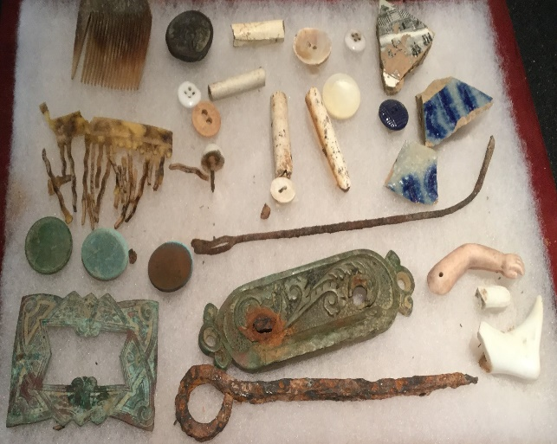
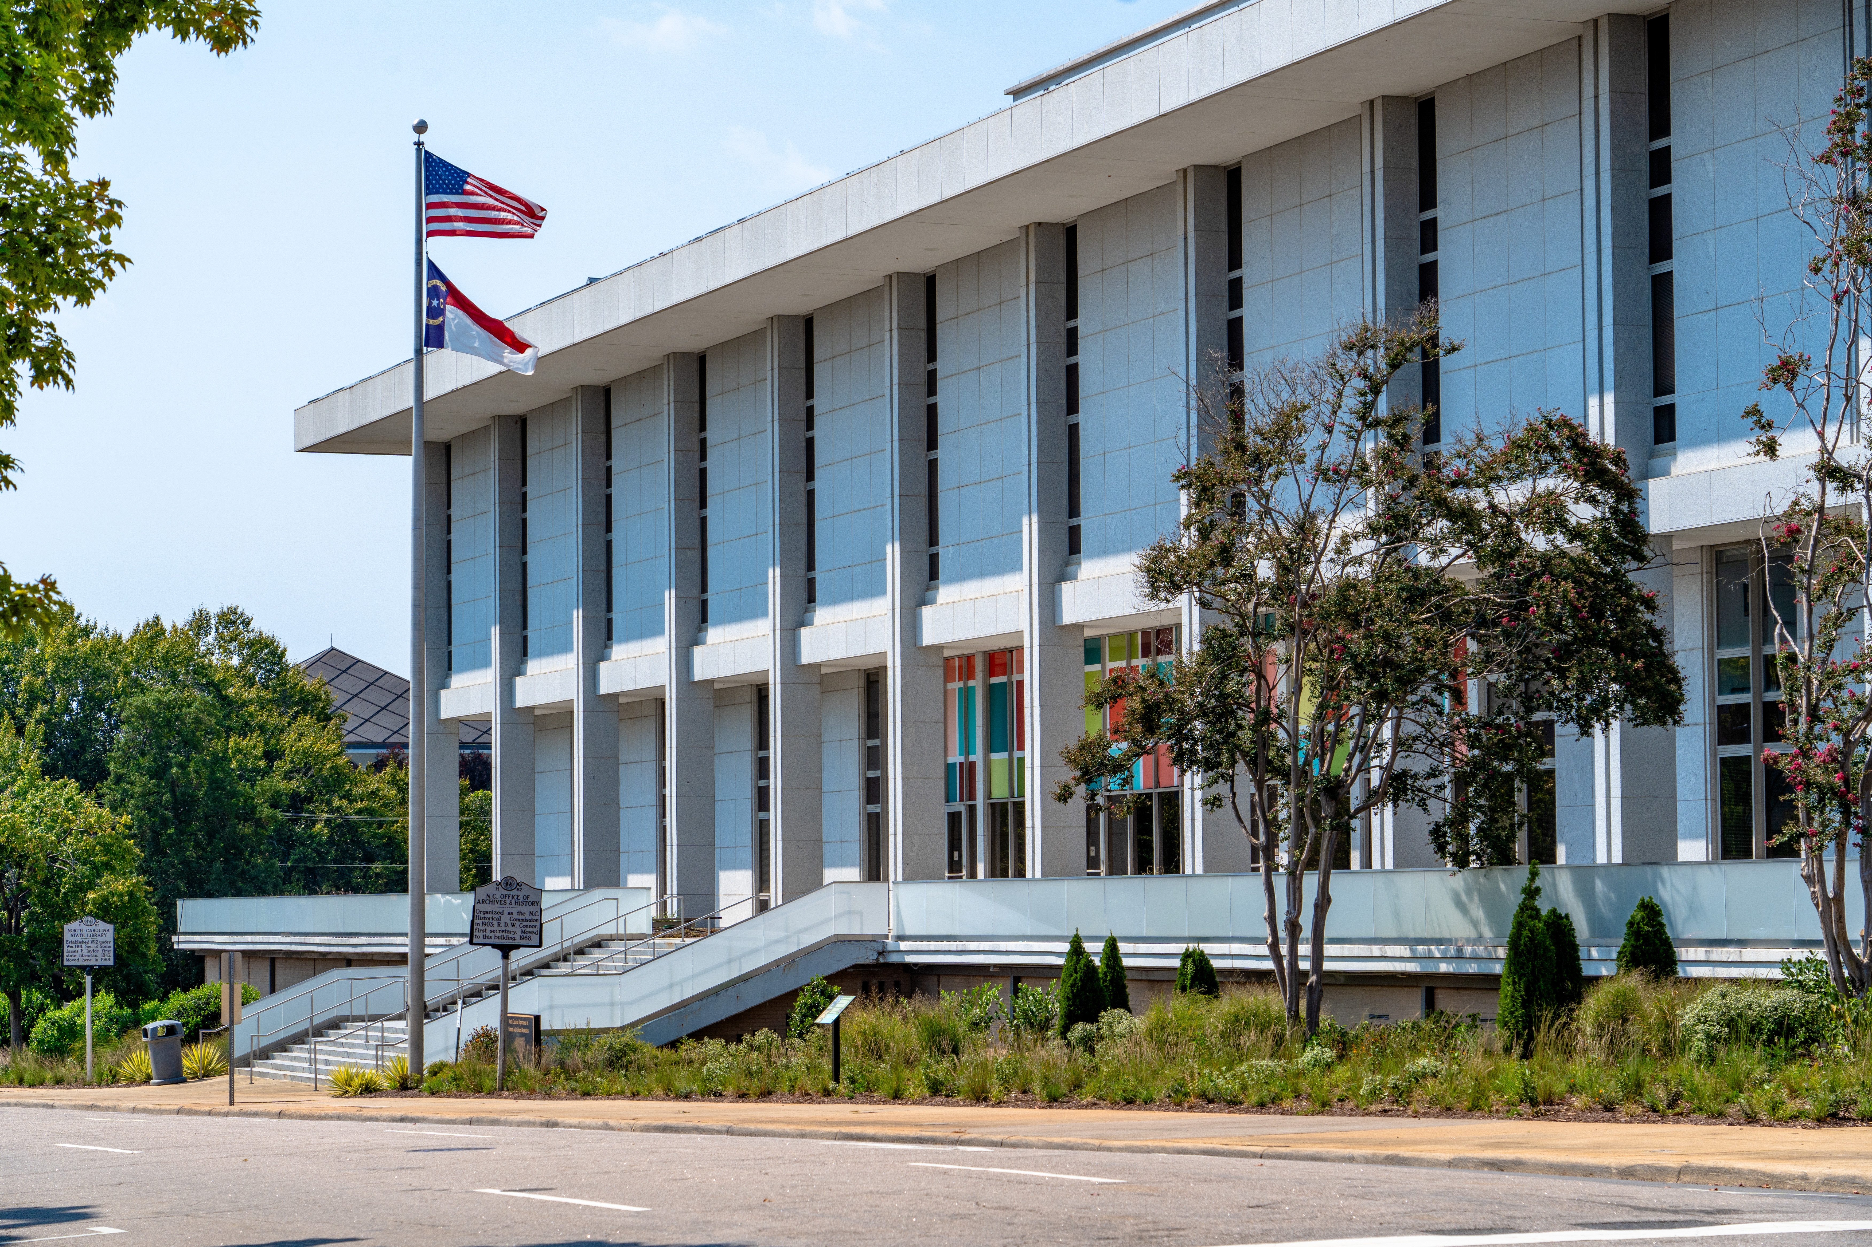
Session 2:
North Carolina
Office of State Archaeology
Asheville, NC

Slide 2
Who We Are
North Carolina Office of State Archaeology (OSA)
Created by the North Carolina General Assembly in 1973
Part of the State Historic Preservation Office (SHPO)
Our Mission
Protect the NC maritime and terrestrial archaeological legacy through the application of state and federal archaeology laws and regulations and by maintaining inventories of site data and artifact collections
Enhance the appreciation of cultural heritage to strengthen the social, educational, cultural, and economic future of North Carolina

Slide 3
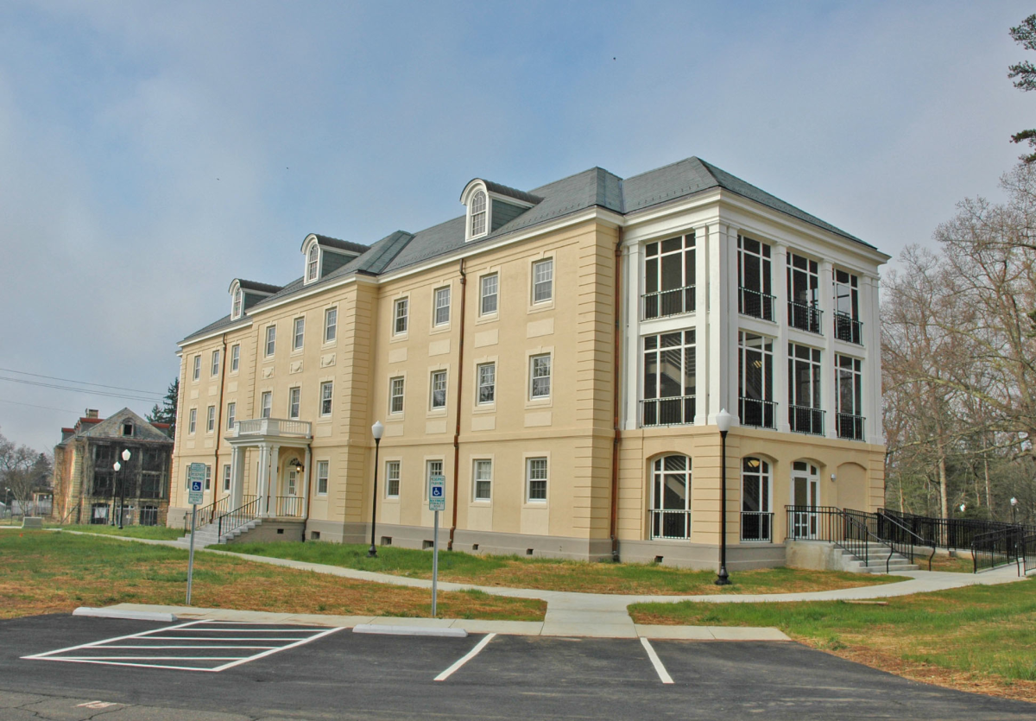
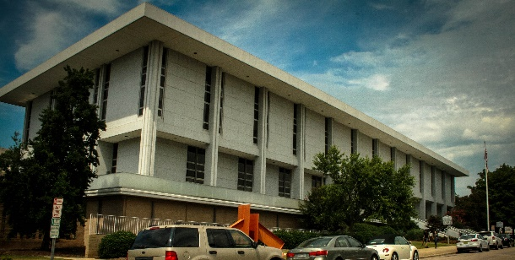
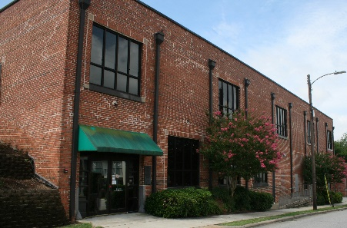
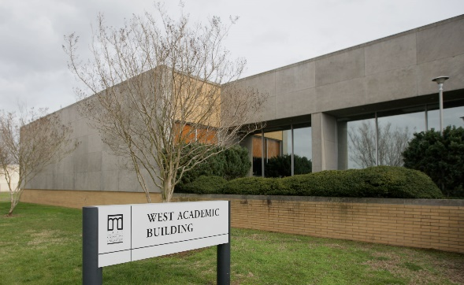
Where We Are located
Greenville
QAR Conservation Lab
Asheville
Western Office
Raleigh
Main Office
OSA Research Center
Kure Beach
UAB Office
Notes:
OSA locations
Main office. Where most of our staff is located. Main function is to perform Environmental Review but also home to our historic cemetery program, GIS program, and houses our statewide report and site form library. One of two offices where background research can be performed.
OSARC: primary curation facility for the preservation and storage of North Carolina's archaeological collections.
Western Office
UAB
QAR

Slide 4
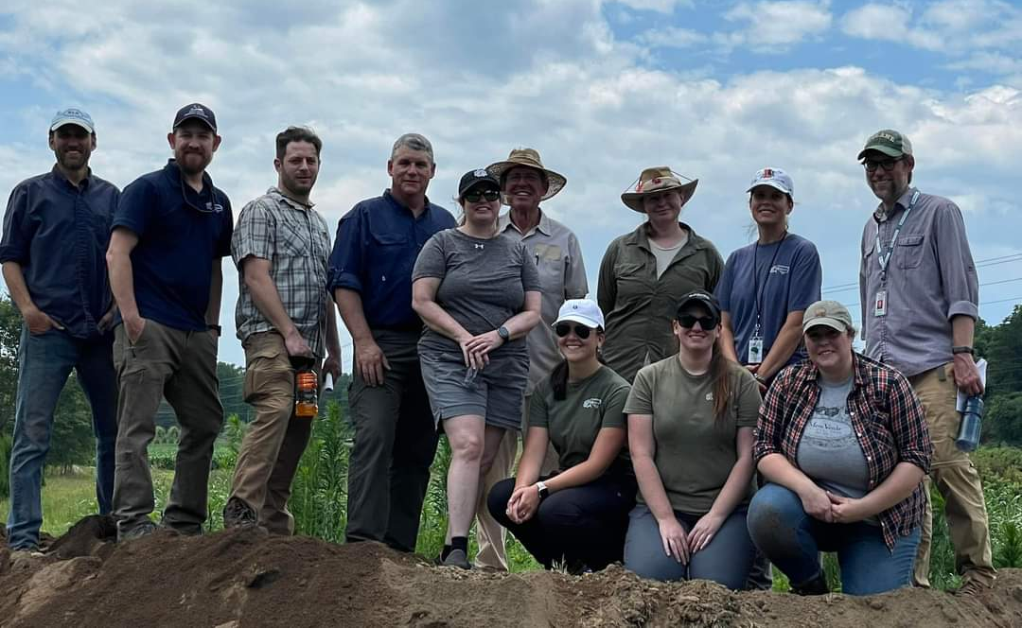
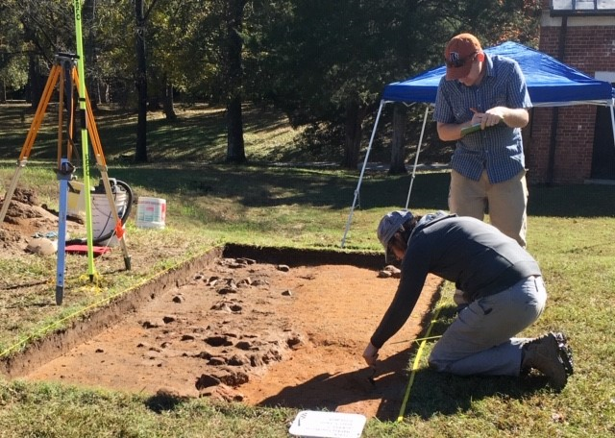
What We Do at OSA
Coordinate a statewide archaeological preservation program by:
Serving as a repository for archaeological data
Implement state and federal cultural resource laws
Provide professional archaeology services to state and local governments
Public education and outreach

Slide 5
Specialty Programs
Historic Cemetery Program
Underwater Archaeology
Artifact Curation and Conservation
ARPA Permits
Underwater Permits
Geophysical Unit
Public Education and Outreach

Slide 6
Current Metrics
Currently have 62,371 Recorded Archaeological Sites
563 new sites registered in so far this year
3,023 were added in 2023, many of which were from our cemetery program
Digitizing
8,313 out of 9,024 reports digitized
Compliance Review FY 2023-2024
2,511 projects reviewed
224 reports added to our library
Updates to data management
High density mobile storage system installed in Raleigh Library
Transitioning databases from Microsoft Access to Laserfiche
Notes:
As I mentioned, a big part of what we do is serve as site file managers. There is a lot of data to manage, some going back to the 1950s and 1960s.
There have been over 62k sites recorded across NC and we maintain a record of each site.
For some of the sites we don’t have much information, maybe just a 3-page form, but for other sites that may have been subject to numerous excavations, we may have numerous reports and a filing cabinet drawer full of information.
We are currently in the process of a large digitization effort. Thanks to the Covid-19 pandemic and a partnership with NCDOT, we have scanned almost all of our over 9,000 reports and we plan to scan our site forms next followed by our environmental review paperwork which dates back to 1970.
Along with digitizing our paperwork, we are updating our data management systems including, installing high density mobile shelving unit to replace our old aluminum bookshelves in our Raleigh library. The new system has allowed us to double our storage space in our Raleigh office.
We also recently transitioned our Environmental Review Access database to a cloud based data manager called Laserfiche and are currently in the process of also transitioning our Site Form database to the same system. We plan to transfer our report database to the system in the future so that all of our data is stored in one easy to use digital platform.
Our goal of our digitization efforts and Laserfiche system is to provide a more efficient Environmental Review process and a more efficient background research process for archaeologists doing compliance work across the state.

Slide 7
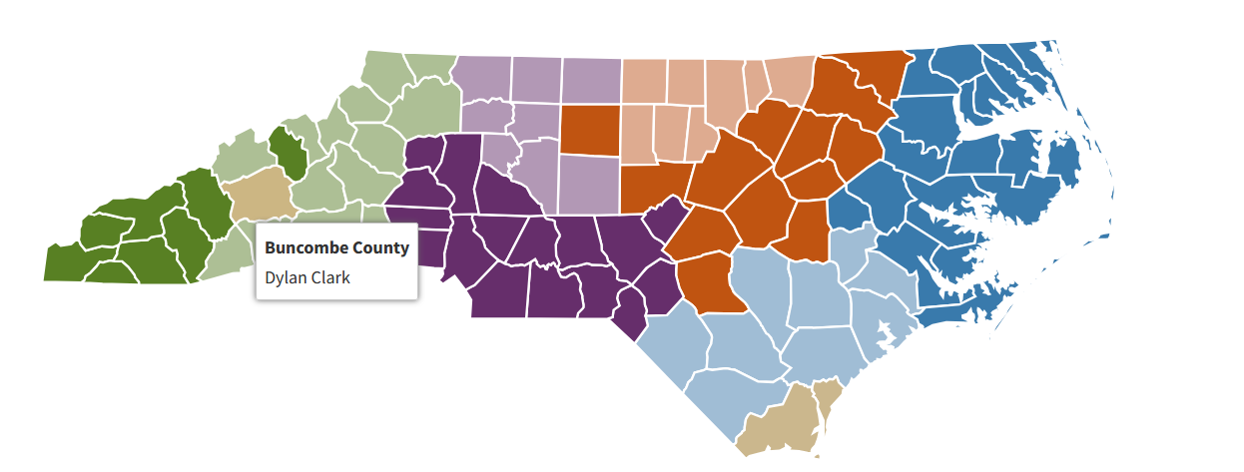
State Archaeologist of NC: Chris Southerly
8 Regions: 6 Assistant State Archaeologists and 2 Deputy State Archaeologists

Slide 8
ARPA Permits
General Statute 70, Article 2: Archaeological Resources Protection Act
Specific permits (may not exceed 3 years)
General permits (may not exceed 5 years)
Application & Background Check Process
Handy Permits tab on OSA website!
Build in sufficient time
Schedule time for reporting (including 60 day review period + 30 days for revisions
Curation (including archival records!)
Notes:
Archaeological Resources Protection Act (State), NCGS 70, Article 2
Permits required to conduct archaeological investigations on state owned or managed land and in state waters
https://archaeology.ncdcr.gov/programs/permits

Slide 9
Find almost anything on our website archaeology.ncdcr.gov

Slide 10
Find almost anything on our website archaeology.ncdcr.gov
Notes:
Archaeology.ncdcr.gov

Slide 11
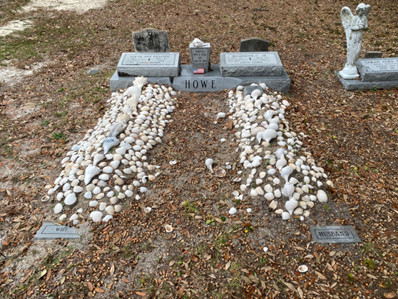
NCOSA Historic Cemetery Program
Purpose:
Contributing to the NC Site File, Research
Questions and Consultation
For the ER process:
Consultation on practices, outreach, mitigation and avoidance strategies (including buffers)
However, most of the process defaults to the NC OSA review staff person
https://archaeology.ncdcr.gov/programs/cemeteries

Slide 12
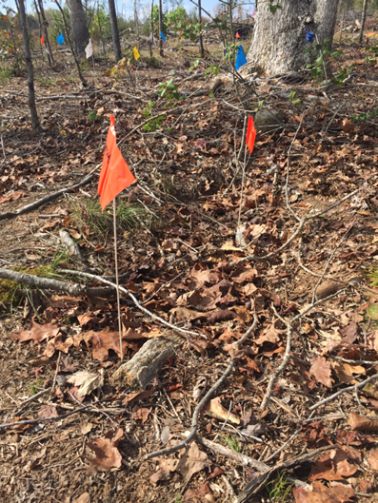
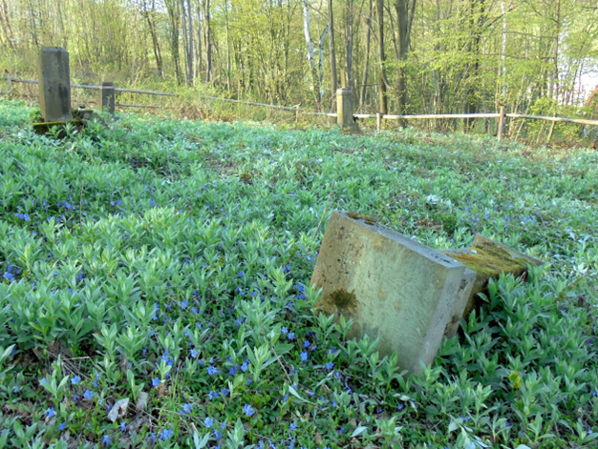
Cemetery reminders
•Cemeteries containing interments greater than 50 years of age should receive a trinomial site number. Please submit a cemetery form to the Site Registrar.
•If the cemetery is associated with other historic site elements, or is located within a prehistoric site, it should be assigned a separate site number.
•Cemetery statutes:
Chapter 65- General cemeteries statutes, cemetery relocation (NC G.S. § 65-106)
Chapter 70- Archaeological burial ordinances, unmarked remains, inadvertent discoveries (NC G.S. § 70-29 through § 70-33)
Chapter 14- Criminal statutes for vandalism, desecration, etc. of remains, cemetery artifacts, and features

Slide 13
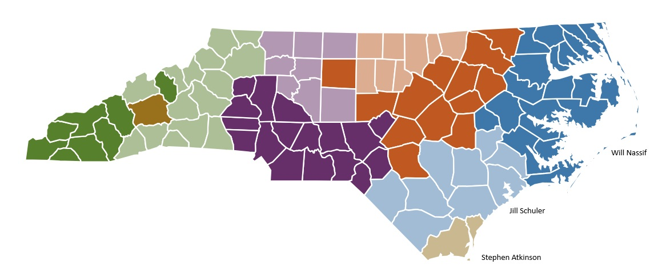
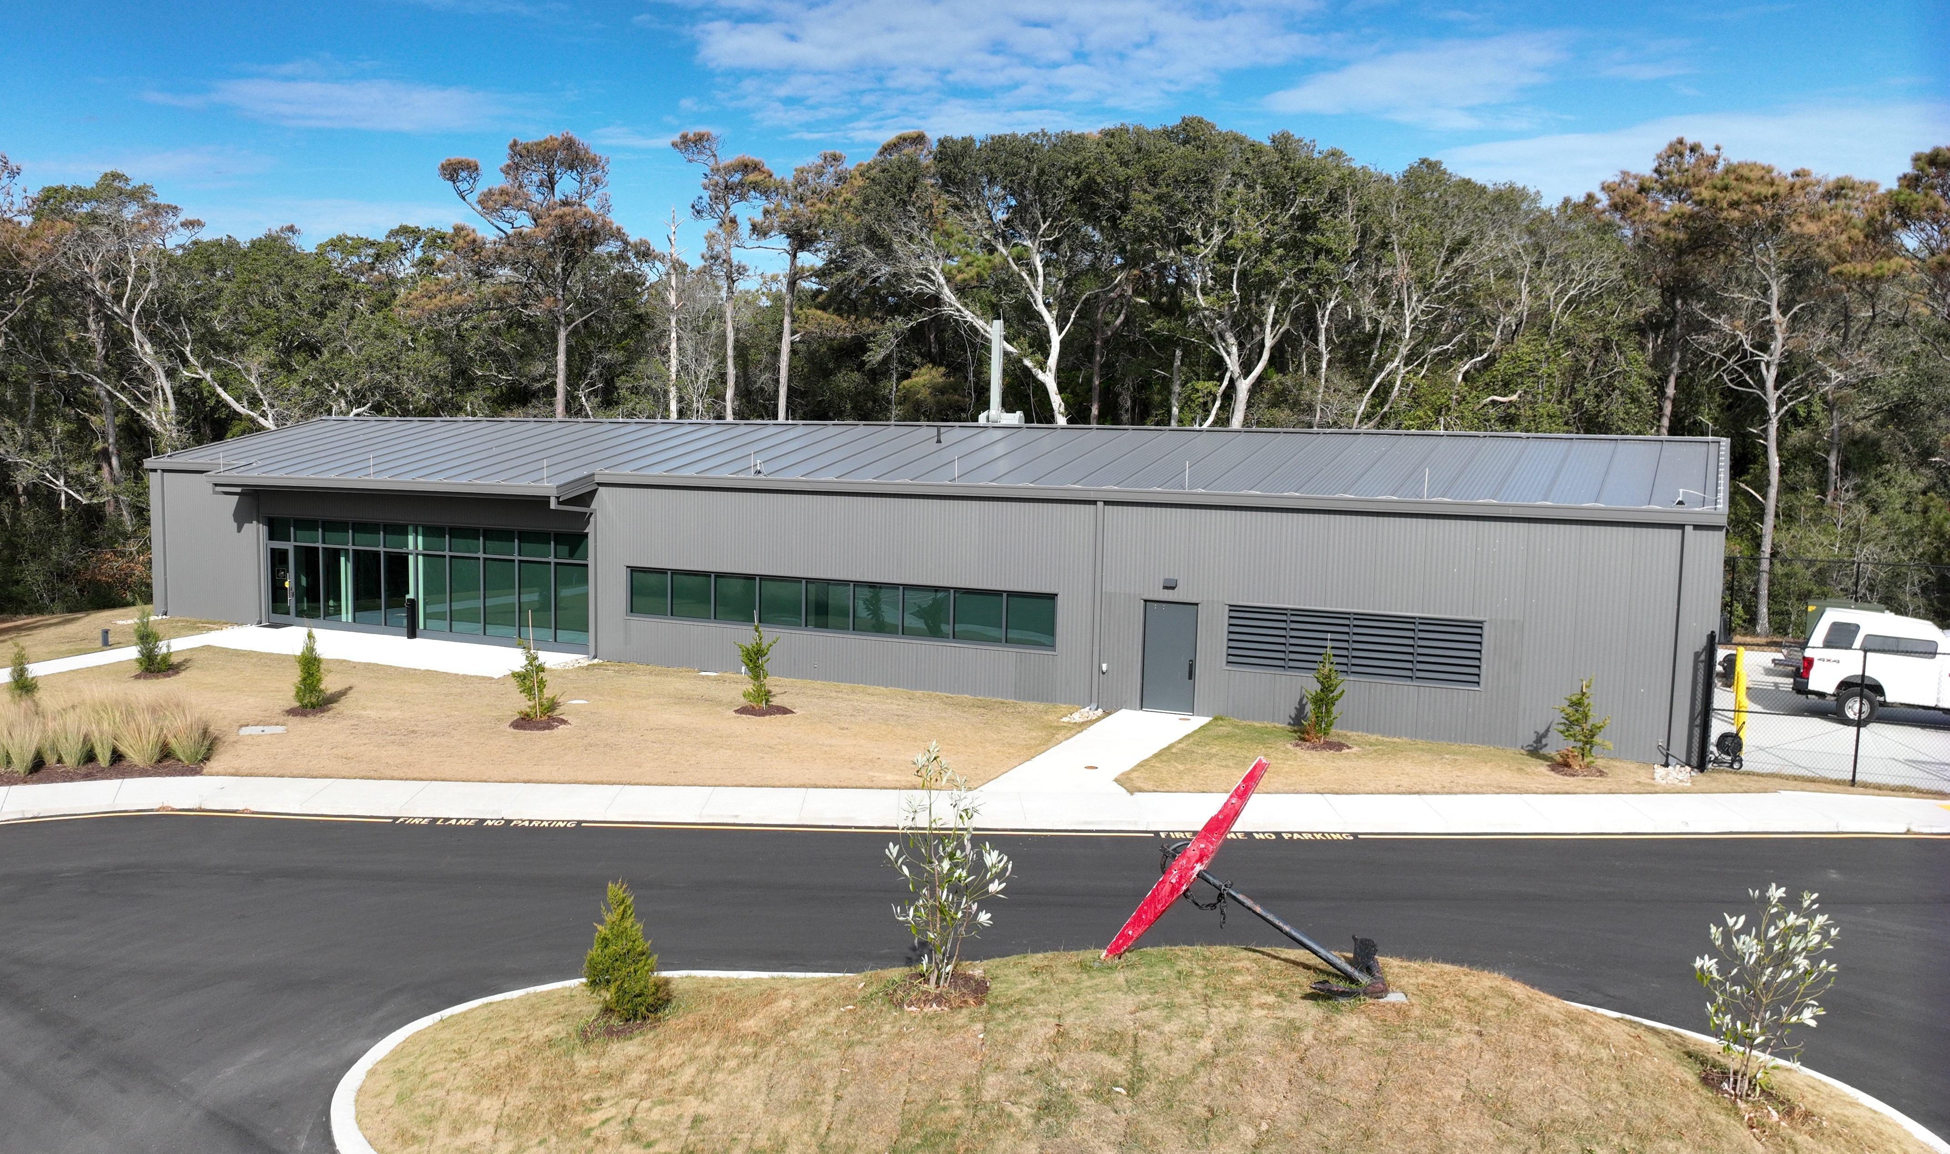
Maritime Archaeology Laws, Regulations, and Procedures
Who We Are
The oldest of its kind in the United States and predating the Office of State Archaeology itself, the North Carolina Underwater Archaeology Branch was established in 1962 in conjunction with the salvage and care of the Civil War blockage runner, Modern Greece. We are responsible for identifying, monitoring, and preserving underwater archaeological resources within rivers, coastal regions, and state waters.
Reviewers:
Stephen Atkinson: Deputy State Archaeologist, Underwater (Tan Counties)
Jill Schuler: Assistant State Archaeologist, Underwater (Light Blue Counties)
Will Nassif: Assistant State Archaeologist, Underwater (Dark Blue Counties)
Madeline “Punk” Spencer: Office Manager

Slide 14
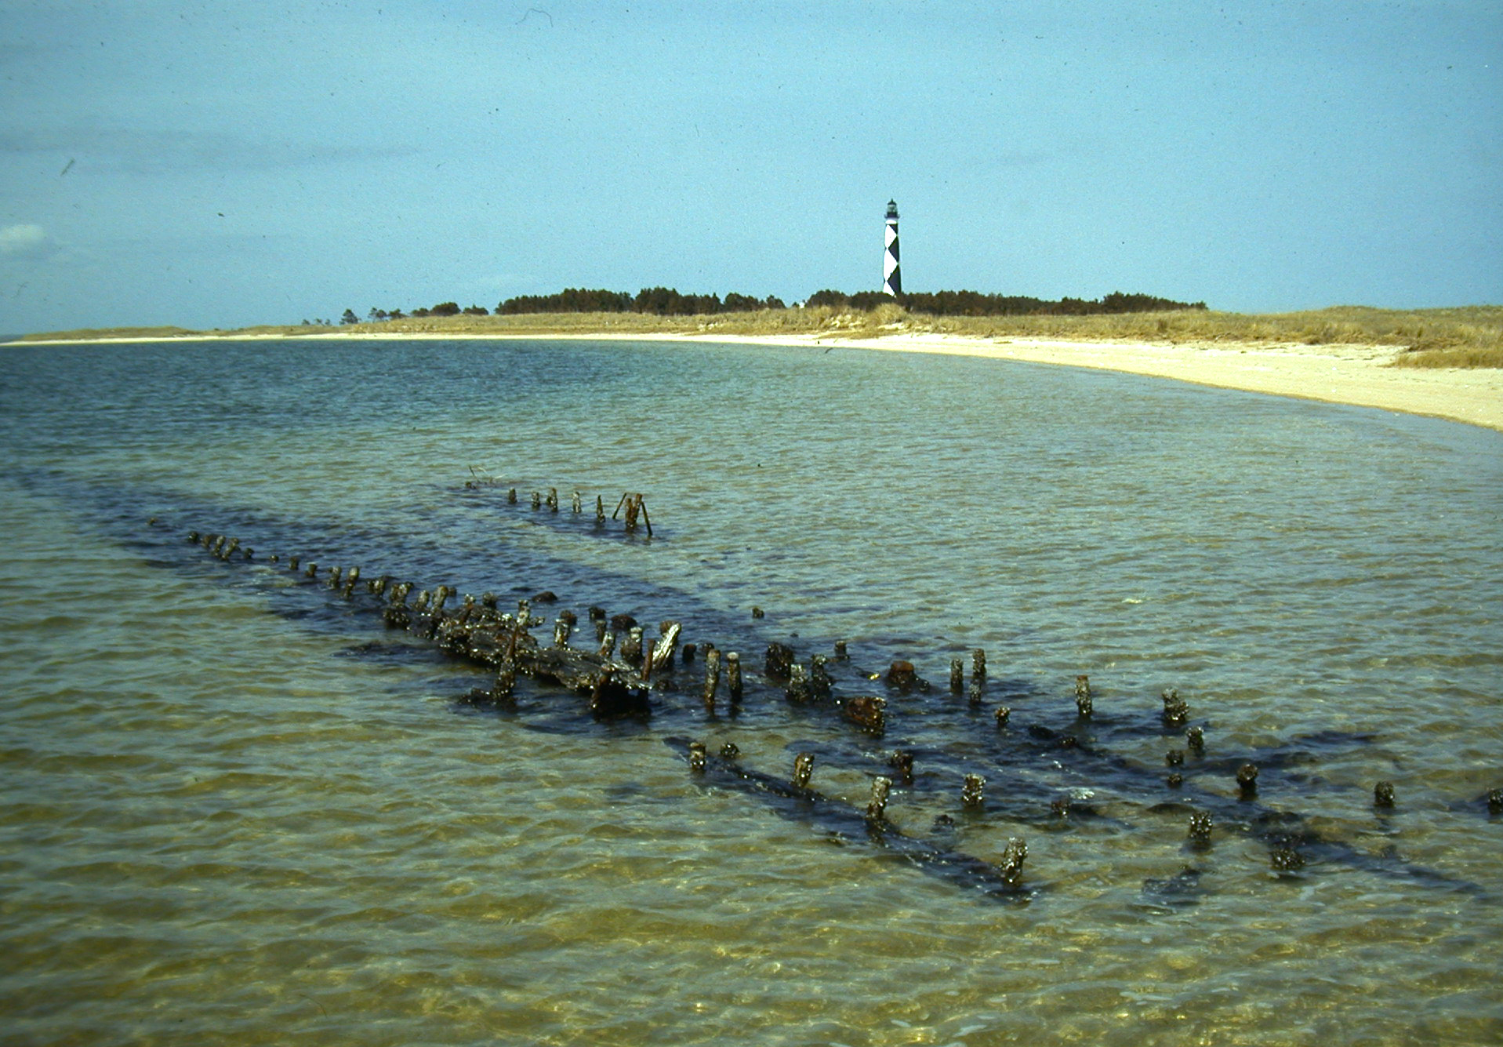
Maritime laws
Abandoned Shipwreck Act, Public Law 100-298
General Statute 121, Article 3: Salvage of Abandoned Shipwrecks and Other Underwater Archaeological Sites
Establishes title for the State to all shipwrecks, vessels, cargoes, tackle and underwater archaeological artifacts abandoned for more than ten (10) years and lying on the bottoms of navigable waters and ocean waters from within one marine league, three nautical miles, seaward from the Atlantic seashore high tide watermark. (State owned bottomlands)
It is the statutory responsibility of the Department of Natural and Cultural Resources to conduct and/or supervise the surveillance, protection, preservation, survey, and systematic underwater archaeological recovery of underwater cultural materials.
https://archaeology.ncdcr.gov/programs/environmentalreview/laws#underwater
Notes:
https://archaeology.ncdcr.gov/programs/environmentalreview/laws#underwater

Slide 15
Maritime Laws Cont’d.
Coastal Area Management Act (CAMA)
In 1974, the North Carolina General Assembly passed the Coastal Area Management Act (CAMA), and set the stage for guiding development in the fragile and productive areas that border the State's sounds and oceanfront. Along with requiring special care by those who build and develop, the General Assembly directed the Coastal Resources Commission (CRC) to implement clear regulations that minimize the burden on the applicant.
113A-101. Cooperative State-local program.
This Article establishes a cooperative program of coastal area management between local and State governments. Local government shall have the initiative for planning. State government shall establish areas of environmental concern. With regard to planning, State government shall act primarily in a supportive standard-setting and review capacity, except where local governments do not elect to exercise their initiative. Enforcement shall be a concurrent State-local responsibility. Requires a permit.
Sunken Military Craft Act
Enacted as: the “Sunken Military Craft Act”, on October 28, 2004, as Title XIV of the “Ronald W. Reagan National Defense Authorization Act for Fiscal Year 2005”
Where Law Applies: Applies to sunken U.S. military ships and aircraft wherever located around the world. It also applies to sunken foreign craft in U.S. waters that are defined to include the internal waters, territorial sea, and contiguous zone (up to 24 nautical miles off the U.S. coast).

Slide 16
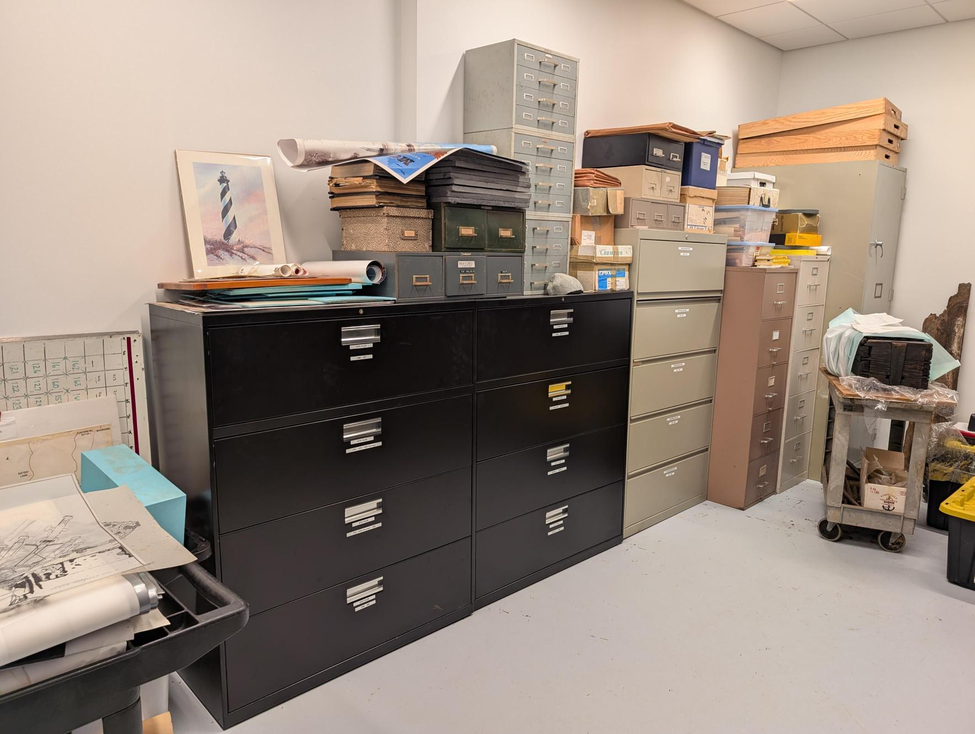
UAB Background research requests
Request made to OSA
Disseminated to UAB
Compiled by UAB staff or those with drive access
OSA sitefiles email notified, files placed in sharefile
Sharefile link sent to requestee
U/W GIS database not yet incorporated into OSA master sitefile database – pulling submerged special data must still be done by UAB staff
Process is same as above for general background research request for UAB shipwreck sitefiles
Do I need a U/W permit?
- Currently gaining clarification on what undertakings would necessitate an U/W Permit
– one permit for remote sensing
– permit different/modified for recovery/mitigation

Slide 17
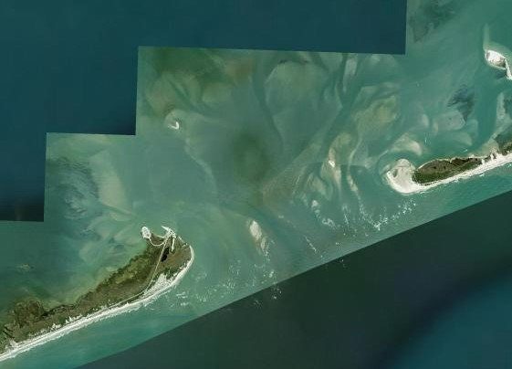
Scoping meeting/submission
Define total APE, assess bottom conditions (depth, hazards, etc.), assess proper tools of survey for that environment
Since our guidelines are not yet codified, this is an essential step for determining what tools are needed for maritime survey
For now, we tend to reference BOEM guidelines for survey
“Guidelines for Providing Archaeological and Historic Property Information Pursuant to 30CFR Part 585”
Other:
mitigation parameters
Post work conservation/curation – if target(s) is not avoided

Slide 18
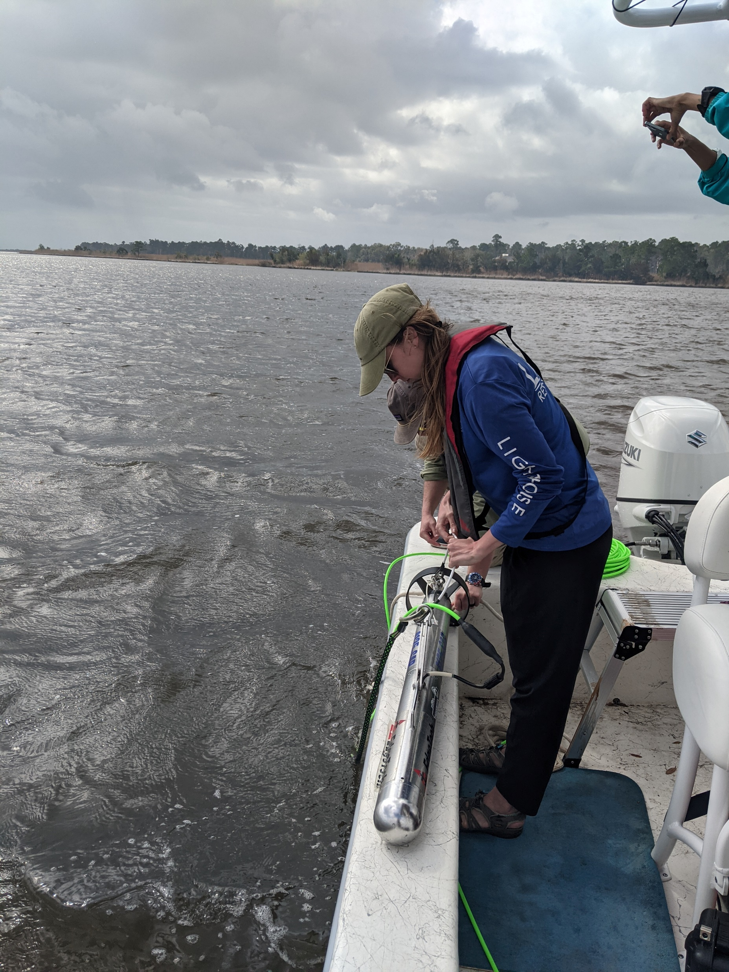
Tools of survey
Minimum requirements at this time:
1. Side scan Sonar
Resolution should be 500 kHz or greater and resolve small targets measuring 0.5 m in length
Tow depth and range should be sufficient to provide 100 percent coverage of the search area, with a minimum overlap of 20 percent between lines, and a resolution better than 0.25 to 0.40 meter for objects on the sea floor. Range should not exceed 100 meters. Typically, using present data state-of-the-art sidescan sonar on every fourth line if surveying with a magnetometer at 40-m line spacing or on every line at 50-m line spacing satisfies this criterion
2. Magnetometer and gradiometer
Altitude should be continuously recorded during data acquisition along survey transects, sensitivity should be 1.0 gamma or less, background noise should not exceed a total of 3.0 gammas peak to peak, data sampling rate should be greater than 4.0 hz to ensure sufficient data point density
Tow the magnetometer sensor at a distance behind the vessel of at least two and one-half times the vessel length. To maximize detection, tow the sensor within 6 meters of the sea floor, as indicated by a depth meter on the sensor. Background noise level in the magnetic datashould not exceed plus or minus 3 gammas. Recommended vessel speed is from 4 to 6 knots. The magnetometer should have a sensitivity of at least 1 gamma and be set to cycle at a rate of approximately 1.2 to 1.3 second intervals. This rate improves location accuracy with the one­second updates provided by the global positioning system and allows for increased magnetometer sensitivity

Slide 19
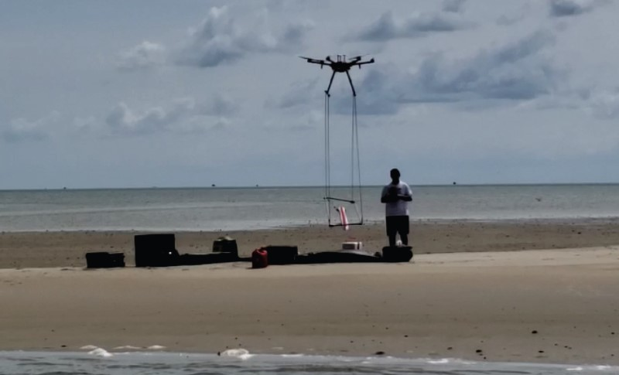
Survey Methods Cont’d.
3. Sub-bottom profiler – as needed (see scope of work)
Survey should be capable of achieving a resolution of vertical bed separation of at least 0.5 min the uppermost 10-15 m of sediments; multibeam echo sounder must provide full coverage with 1000/4 overlapping data
4. All tools must be routed through a DGPS system to collate remote sensing data with spatial data
5. Ground truthing – target diving
Should necessitate a permit if ground disturbance/excavation
Hydroprobing, visual inspection, imagery (photo, video, 3D)
Other:
Contact us/see scope of work for alternatives (Drone Mounted Magnetometer, Multibeam etc.)

Slide 20
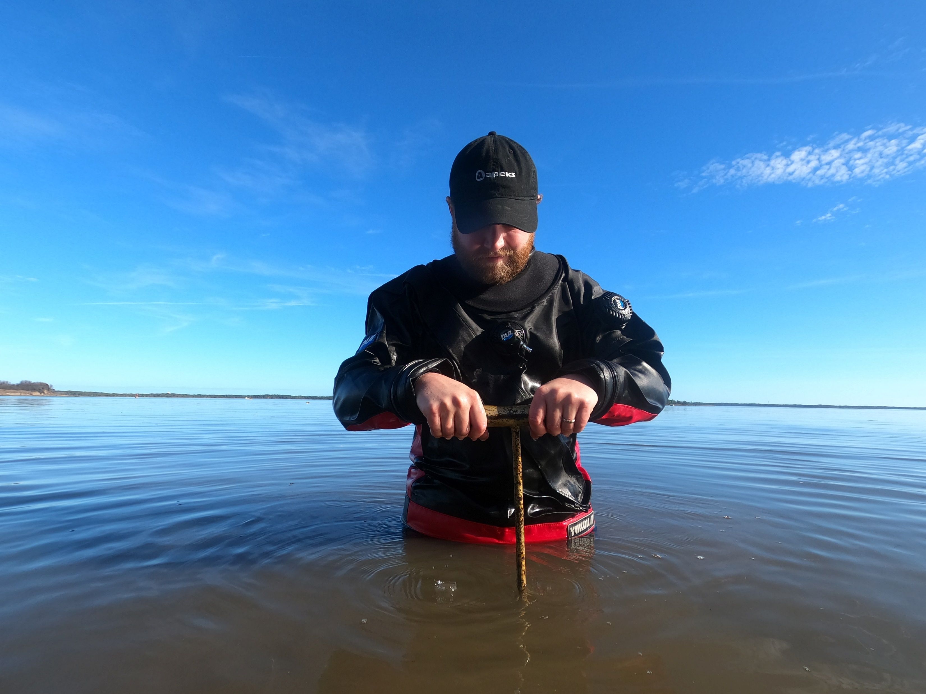
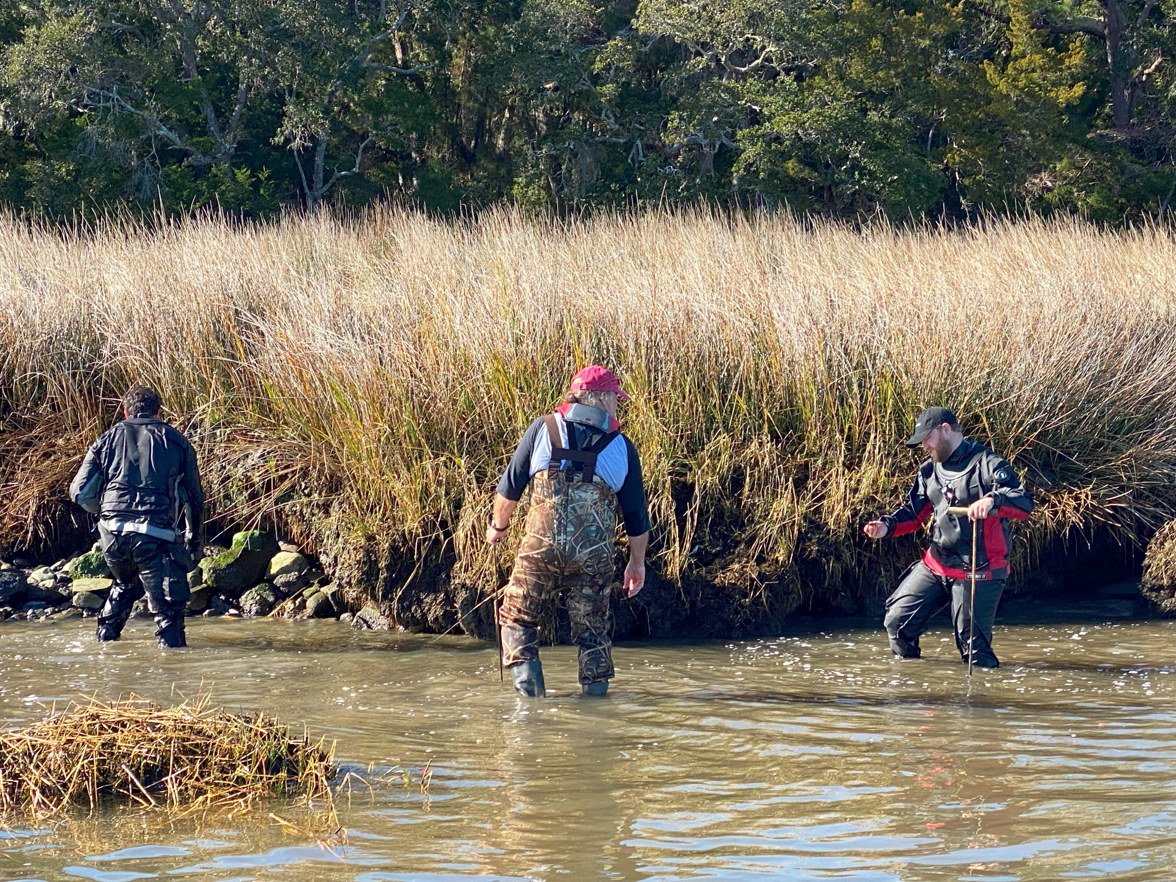
Shoreline surveys/intertidal zone surveys
Somewhat non-traditional 106 compliance
Eroding middens, sunken cemeteries, intertidal wrecks, shipyards,
sites of industry
Scope of work
Methods – shovel test where able
pedestrian survey – waders, high boots
Wade as far out as safely can be done in a pedestrian survey
Probing
Documenting sites as they erode – eligibility in jeopardy
GPS minimum/RTK preferred to record surface scatter/finds
Photo documentation - to reduce water surface glare – remove artifact from water to photograph once special data achieved, return to context if not collecting

Slide 21
Contact US!
https://facebook.com/ncarchaeology
https://instagram.com/ncarchaeology/
Raleigh Office
109 E. Jones Street Raleigh, N.C. 27601
(919) 814-6550
archaeology@dncr.nc.gov
Western Office
176 Riceville Road
Asheville, NC 28805
(828) 250-3109
dylan.clark@dncr.nc.gov
Rach.denton@dncr.nc.gov
www.ncdcr.gov/about/history/western-office
Underwater Archaeology Branch
1528 Ft. Fisher Boulevard
South Kure Beach, NC 28449
910.251.7320
uab@dncr.nc.gov
archaeology.ncdcr.gov/underwater-archaeology-branch
Research Center
215 W. Lane Street
Raleigh, N.C. 27601
(919) 715-5599
emily.mcdowell@dncr.nc.gov
archaeology.ncdcr.gov/programs/curation
QAR Lab
West Research Campus
East Carolina University
1157 VOA Site C Road
Greenville, NC 27834
(252) 744-6721
qar@dncr.nc.gov
www.qaronline.org

