Slide 1
2025 Section 106/ER Workshop
Hosted by the
North Carolina
Historic Preservation Office
&
Office of State Archaeology

Slide 2
Welcome!
With
Chris Southerly, State Archaeologist
&
Renee Gledhill-Earley, Environmental Review Coordinator

Slide 3
2025 Workshop: Session 1
The Basics & ER Branch Updates
SUBTITLE
A Map of North Carolina c. 1832
By A. Finley, Young & Delleker, SC
Notes:
Please hold your questions until the end of the presentation. If you happen to think of any after we have concluded, you are welcome to bring them up during the panel discussion.
Photo - A Map of North Carolina c. 1832, By A. Finley, Young & Delleker, SC (https://dc.lib.unc.edu/cdm/singleitem/collection/ncmaps/id/623/rec/38)

Slide 4
ER Branch Project Updates
Digitizing the Report Library

Slide 5
ER Digitization Project
Project started in 2018
"Baton was passed" in 2024
1400 Historic Structure Survey Reports total in Library
320 needed digitization
220: simple scanning
60: missing Determination of Eligibility letters
40: completely missing
Notes:
As the archivist of SHPO, I not only help my team with processing incoming reports (all the records are spick and span)
Main goal: Broaden access
Why? The reports you send to us aren't just analytical data,
it's our cultural heritage. Y'all are creating a historical record

Slide 6
Challenges to the digitization process
Screening of confidential data
Varying records retention policies
Department of Transportation, Federal Highway Administration
Convoluted organization of prior reports
Differing procedures for each kind of record
Maps, photos, bound copies, etc...
Large-format scanner, Zeutschel scanner
Miscellaneous older reports not being added to ER Library
Notes:
2021: US 19 project near Bryson City) Kituwah in Swain County, location/pin information redacted
Inactive records are discarded depending on the organization
Complicated because older reports (ancient history) only have 2-4 copies in existence.
To SHPO, they have permanent value due to research potential
Dogwood Inn in Rutherford County (Beth from survey), DOE in 1994

Slide 7
Progress thus far
Notes:
Total: From 320 to 44
Missing DOE letters: From 60 to 26
Missing: From 40 to 18
The 26 reports with Missing DOE letters are already digitized.

Slide 8
ER Branch Project Updates
Moving to Laserfiche

Slide 9
Laserfiche Development and Implementation
Process began 2021 to transition our system from Microsoft Access Database to dynamic platform
Platform developed to maintain Office of State Archaeology's Site Forms and Environmental Review data-bases
The process, from scope of work to completed database, took four years. Completed May 2024.
Pros
Cons
Every reviewer has a task list with the due date listed
We can assign priority levels
Not much easier to relocate projects/information
Compiling data takes just as long as before
Notes:
A year after I started in this position, we began the transition from a Microsoft Access database and spreadsheet based notification system to a dynamic database. Our office landed on Laserfiche, a program administered through MCCi. Overall, the process from start to finish took three years. We developed the scope of work, lead the team on developing the database, and implemented the changes. We are still in the process of cleaning up the data to this day while also making sure that all aspects of the environmental review process are tended to. [READ PROS AND CONS] Otherwise, everything is about the same. Ideally, we would also have a submission portal for everyone to submit their projects through, but funding cuts and the costs to maintain the form preclude implementation.

Slide 10
Project Workflow
Review Request Submitted
Survey assigns projects
Survey reviews for structures
Letter sent for ERC’s approval (if comments)
Return HPO letter to applicant
Processing Team uploads data to Laserfiche
Archaeology processors review and reassign project
Archaeology reviews for archaeological sites
Notes:
The introduction of laserfiche has not substantially changed our workflow. The review request is submitted and logged in by my team. The archaeology processors double check the submission and pass it along to the archaeology reviewers. Then, survey and archaeology concurrently review the projects. If there are any specific comments, Renee reviews the letter and approves the language. Finally, the completed letter is returned.

Slide 11
HPO WEB and GIS

Slide 12
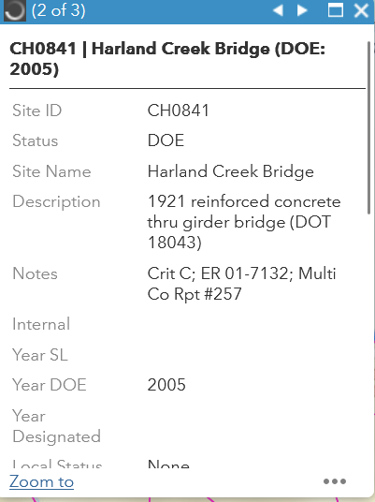
HPOWEB/GIS

Slide 13
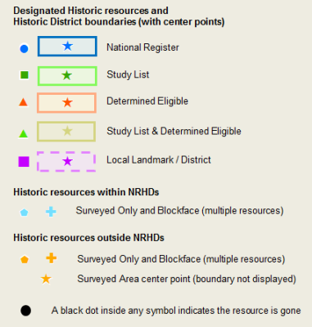
HPOWEB/GIS
The Basics
Maps and Data available online on HPOWEB + Our Website
Link: https://www.hpo.nc.gov/survey-and-national-register/gis-maps-and-data
Includes basic glossary of terms, i.e. SO, SL, DOE, NR, etc.
Resource type have a specific color and shapes
HPOWEB does NOT include archaeological sites
Notes:
https://www.hpo.nc.gov/survey-and-national-register/gis-maps-and-data

Slide 14
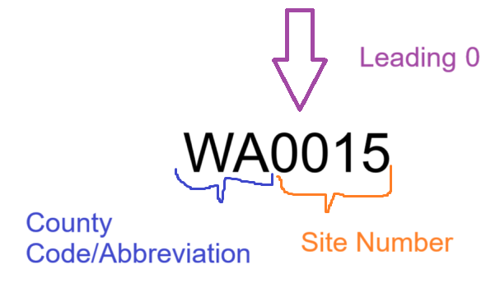
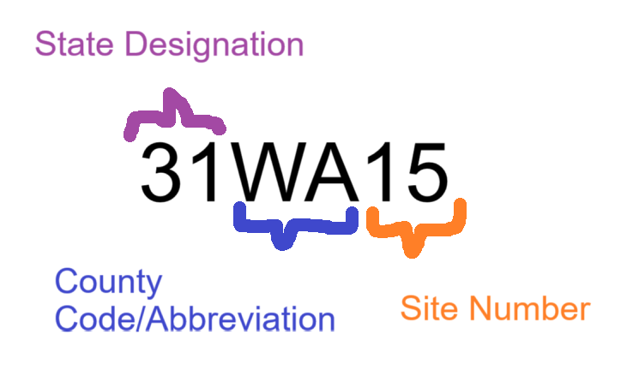
HPOWEB/GIS
Anatomy of an SSN
Anatomy of an Archaeological Site Number
The Basics
HPOWEB displays non-archaeological recorded properties and historic properties (36 CFR 800.16(l))
If it has a Survey Site Number (SSN), there is a file and database record at SHPO. What is in the file varies greatly.
A property screened by SHPO does not get an SSN by default
Gone properties are confirmed completely gone with no above-ground remnants

Slide 15
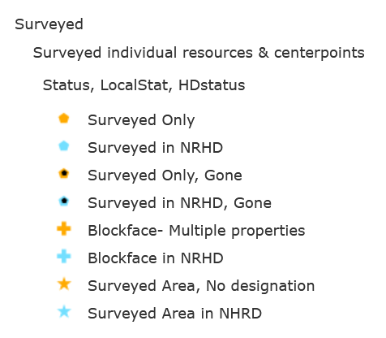
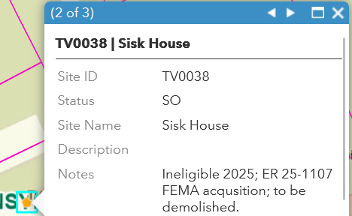
HPOWEB/GIS
Surveyed Only (SO; Tan Color; Pentagon)
A surveyed property is NOT a historic property (36 CFR 800.16(l))
Surveyed properties simply means there is a file at SHPO
Files may include full database entries with photos, plan drawings/sketches or as little as a newspaper clipping or handwritten notes
Notes field in HPOWEB will indicate if an evaluation or other event has occurred
Surveyed Only properties in Historic Districts may be contributing properties, check Notes or the NR nomination!

Slide 16
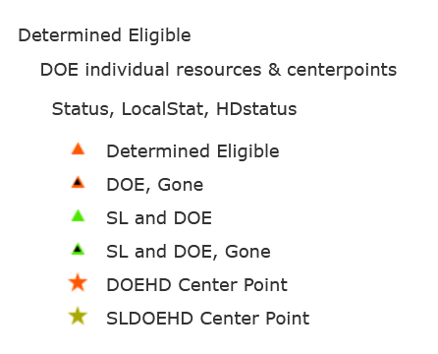
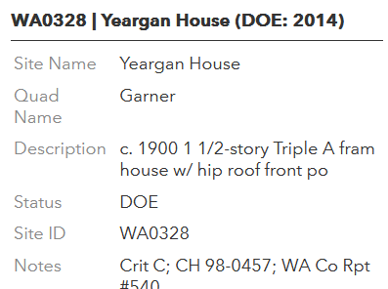
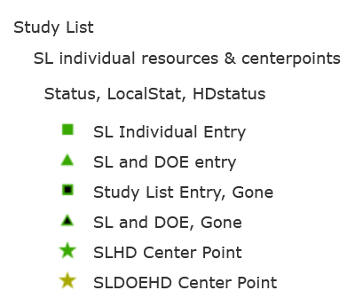
HPOWEB/GIS
Determined Eligible (DOE; Orange Color; Triangle)
SHPO has determined a property eligible for listing in the NRHP (36 CFR 800.16(l))
Study Listed (SL; Green Color, Square)
Potentially eligible
Codified in state administrative code
Reviewed by National Register Advisory Committee (NRAC).
No mechanism to remove a property from the SL, check GIS notes for more info if any available
Not formally a part of ER review
For Section 106 purposes, DOE and SL properties are historic properties
Notes:
DOE is usually the result of a DOE request on a property, or as a result of a requested HSSR as part of Environmental Review.

Slide 17
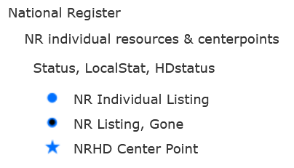
HPOWEB/GIS
National Register-listed Properties (NR, Blue Color, Circle)
Full NR Nomination form
Reviewed by NRAC
Forwarded to the Keeper
Eligible for grants, tax credits, etc.
Surveyed Only properties in Historic Districts may be contributing properties, check the NR nomination!

Slide 18
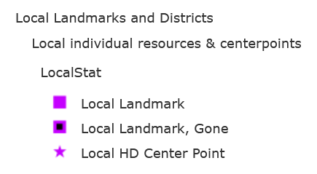
HPOWEB/GIS
Locally Listed (LL; Purple Color; Large Square)
Certified Local Government Program
Locally Listed by themselves are not historic properties for Section 106 compliance
How they are involved with Section 106 discussed towards the end of session

Slide 19
Submissions & Review

Slide 20
How is ER/Section 106 Different in NC
Projects may be submitted for review in anticipation of Section 106 compliance, "Due Diligence"
Anyone can initiate project review, SOI-qualified individuals not required
Background research for archaeological sites is not required for initial project review initiation
SHPO and OSA screens the project area and determines if an historic structures survey and/or archaeological survey is required
Assessment of Effects not required unless you're a Federal Agency
State-funded projects are reviewed under G.S. 121-12(a) and only need to consider effects on already listed National Register of Historic Places historic properties.
Notes:
See Slide - Verbatim

Slide 21
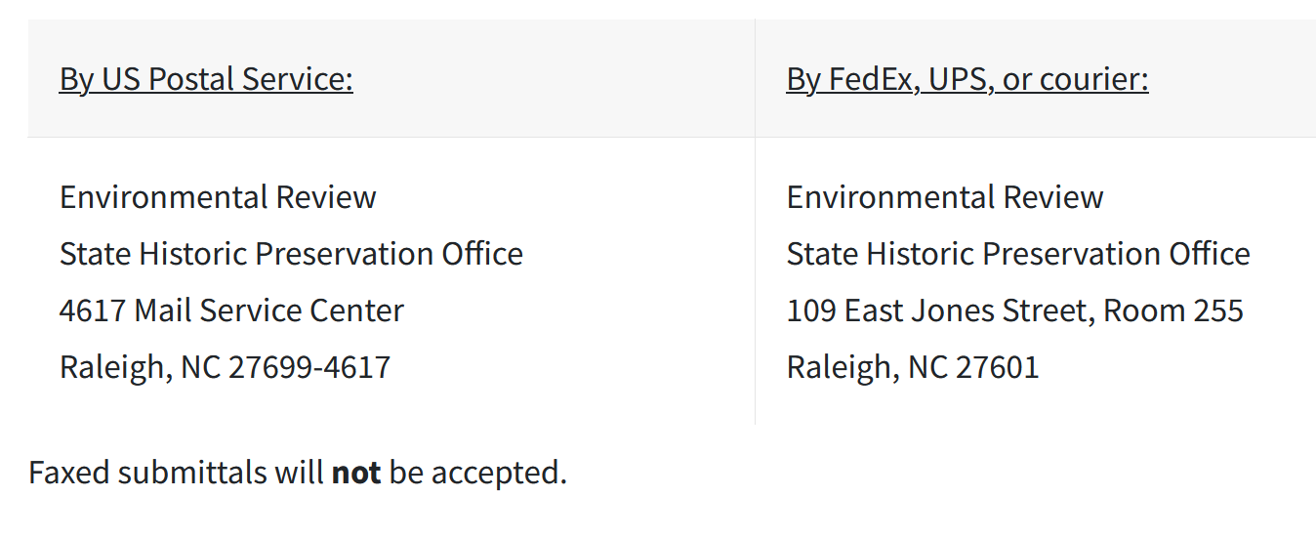
Environmental Review Submissions and Processing
Check out the project review checklist! 99% of your questions are answered there! www.hpo.nc.gov
Submit all projects to environmental.review@dncr.nc.gov
Submitting to reviewers, Renee Gledhill-Earley, Ramona Bartos, or Dr. Darin Waters WILL CAUSE DELAYS!
Notes:
I just want to give a quick overview of the ER sbumission process and expectations. First off, please be sure to checkout our project checklist on our website. We do not believe anything is optional within the checklist and we will turn around projects if we do not have the requested information. I will discuss that later in this presentation. All projects should be submitted to our environmental review email inbox at envrionmental.review@dncr.nc.gov. If you are submitting​​ project materials via the regular mail, please make sure you address Renee Gledhill-Earley. Sending projects to reviewers, Renee Gledhill-Earley, Ramona Bartos or Dr. Darin Waters will cause delays as they have to turn around and route the projects back to me. We outline the submittal process in our checklist and all of our letters.

Slide 22
Reasons why submissions are rejected before review begins
Poor maps/maps missing on original submissions
Maps showing the APE in conjunction with parcel data preferred
Not providing the acreage of the Area of Potential Effects (APE)
Not providing the applicant contact information (Name, company, email)
Listing potential funding/permitting or if it is due diligence.
Missing deliverables for Historic Structure Survey Reports (HSSRs) and Archaeological Survey Reports
Specifics covered in Session 3
Notes:
I also wanted to outline the reasons why submissions are rejected. Until we receive all required information, we do not start the 30 calendar-day review period. Our top rejection reasons are.... [read the things].

Slide 23
How to Interpret SHPO Letters
What does the no comment letter language mean?
"We have conducted a review of the project and are aware of no historic resources which would be affected by the project. Therefore, we have no comment on the project as proposed."
Accounts for architectural and archaeological resources (SHPO + OSA comments)
No further work
If a historic property or recorded property is within the APE or adjacent, the project will have No Effect on them
Request for Information (RFI), survey requests, evaluations, No Adverse Effect, Adverse Effect will not use the “No Comment” language above.

Slide 24
Section 106 Odds and Ends

Slide 25
FCC Submissions
Two forms for cell tower submission
Updated this week!
Communications Tower Information Form
New cell towers, co-locations, and single small-cell poles
FCC 620/621 form is not required
Do not need to identify archaeological sites on the form
No archaeological surveys needed unless requested by OSA
All archaeological surveys need to be submitted through OSA ShareFile
Small-Cell Batch Form
Small-cell poles under 50' in height
Poles within 1 square mile
Can exceed distance if requested before submission
Forms Link: https://www.hpo.nc.gov/environmental-review/environmental-review-project-submittal/forms-guidance-and-toolkits
Notes:
Use the most recent form! We just updated them this week! https://www.hpo.nc.gov/environmental-review/environmental-review-project-submittal/forms-guidance-and-toolkits

Slide 26
Solar Farms and FERC Form 556
Per Advisory Council on Historic Preservation comments, Federal Energy Regulatory Commission (FERC) Form 556 is not an undertaking.
Solar farms typically fall under Qualifying small power production facilities (QF; < 80 MW), which uses for FERC Form 556
FERC Form 556 is self-certifying and therefore FERC does not take any discretionary action
Projects that come through the SCH typically only identify FERC Form 556 and other state permits and therefore fall under State Review: G.S. 121-12(a).
The size of solar farms often require ACOE permit which then triggers Section 106 and the APE may be smaller than the overall solar farm footprint

Slide 27
Working with CLGs & HPCs
Locally Designated Historic District (LHD)
Project is within LHD or is individually landmarked and there are Historic Properties
SHPO will note in our letter that the designation exists, encourage the applicant to reach out for COA requirements and provide contact information for the local commission
Local commission POC will be copied on the letter
What if the locally designated property is not considered historic by the NC SHPO?
SHPO will determine that there are “No Historic Properties Affected” but will still provide the information above.
Minimizing or Resolving Adverse Effects
SHPO will often defer to the preferences of the local community and commission for strategies to minimize or resolve effects
National Register-listed Historic District (NRHD)

Slide 28
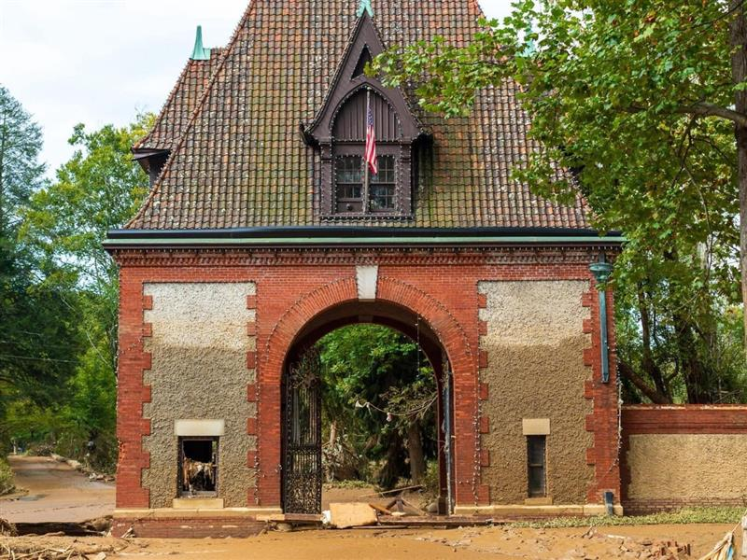
Disaster Recovery
Prioritized and Expedited review
Recovery reviews can add 1-2k reviews/yr
Who submits? Mostly federal or state agencies but the type of emergency may result in different funding paths & review requirements. Ex. COVID-19 > ARPA
NC disaster-specific PA with FEMA since 2020
Working to execute statewide PA; Goal is Summer 2025.
New PA would allow other agencies, like DHUD, to use the PA’s outlined processes to complete their Section 106 reviews.
Helene Flooding levels at Biltmore gate, Photo by Matt Henson, 2024
Notes:
-Prioritized and Expedited review
-Recovery Reviews can add 1-2k reviews/yr
-Projects are usually submitted by federal or state agencies but the COVID emergency resulted in many submissions from municipalities or their consultants.
-Since Hurricane Matthew, NC has been working under a disaster-specific PA with FEMA
-Currently consulting on a statewide PA that would cover all disasters as they occur. Goal is Summer 2025.
-New PA would allow other agencies, like DHUD, to use the PA’s outlined processes to complete their Section 106 reviews. This would help streamline the administration of CDBG-DR funds for example.

Slide 29
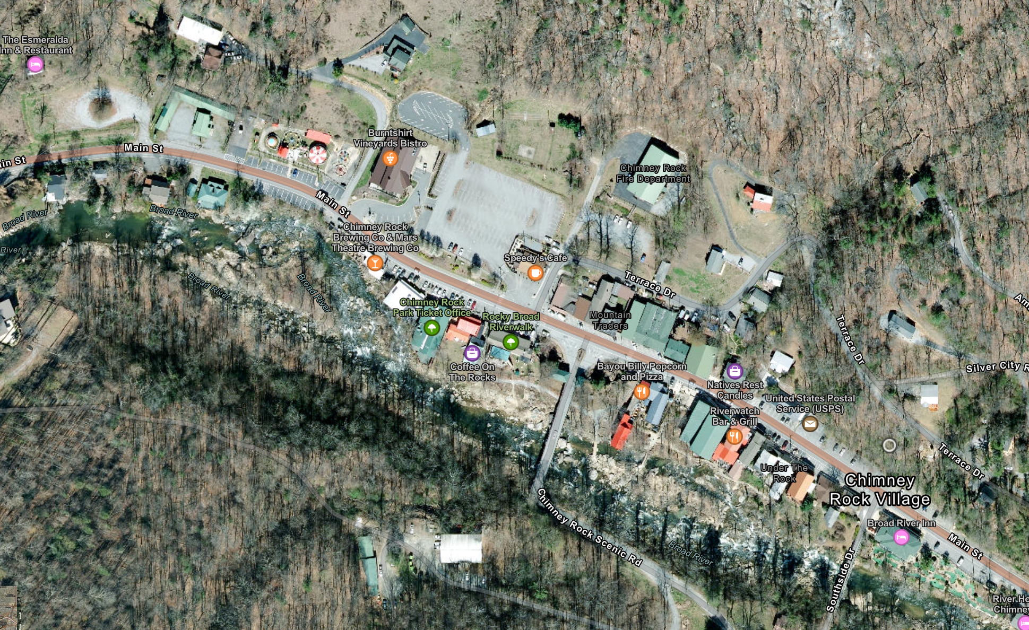
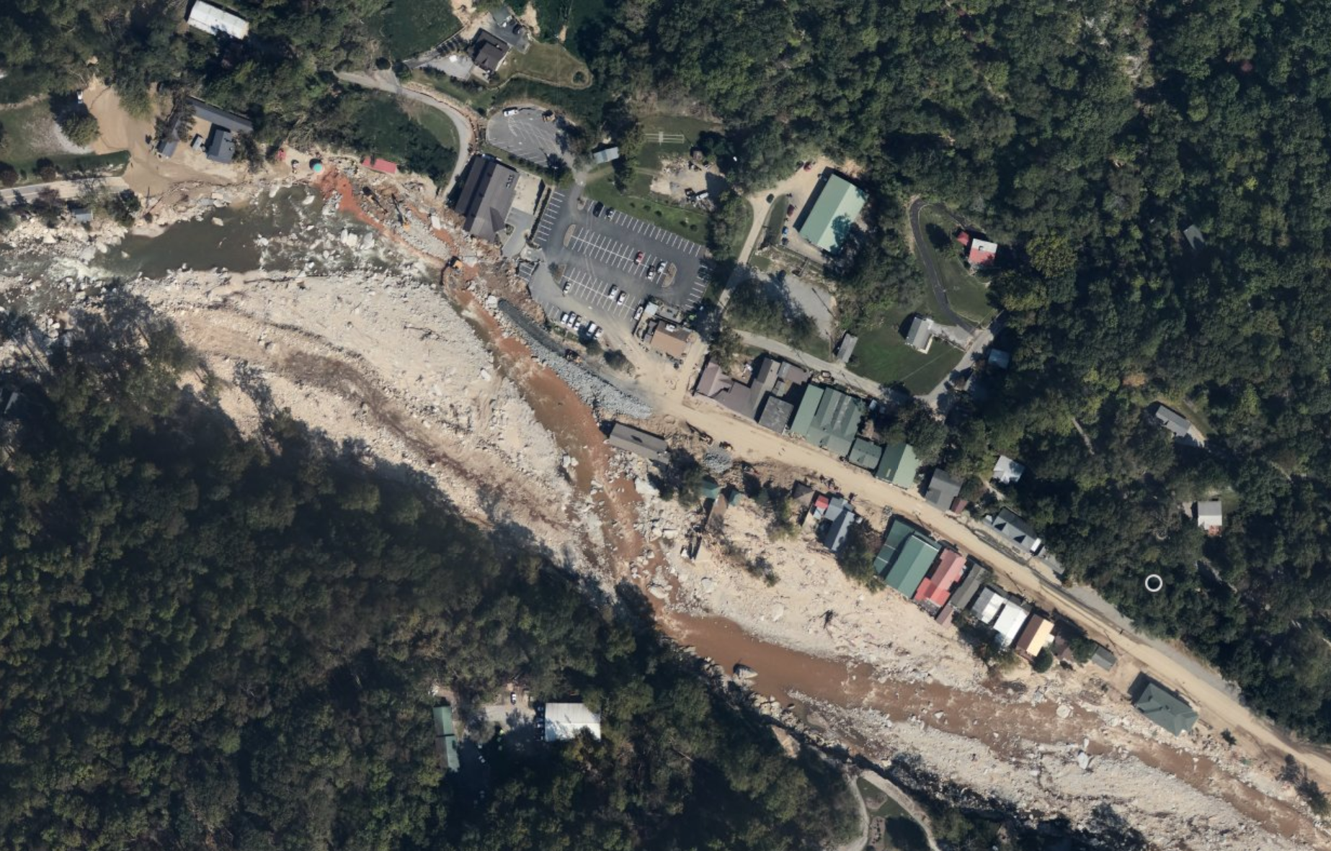
Tropic Storm Helene Recovery
NOAA Hurricane Helene Before and After https://www.arcgis.com/apps/instant/media/index.html?appid=fe5193ccf48f48e3a2129b6c394ee886

Slide 30
Tropical Storm Helene Recovery
NCDEQ Division of Waste Management Temporary Debris and Reduction Sites
186 sites reviewed to date
Transportation Projects
I-40, temporary bridges, bridge inspections, 90%+ roads reopened, 200+ bridges + 800+ culverts repaired, most Section 106 review will be covered under our PA with USACE, NCDOT, and FHWA
NPS and Blue Ridge Parkway
Linville Falls building, historic property/contributing resources losses
157 out of 252 miles of road open (60%+)
FEMA
200+ acquisitions or elevations

Slide 31
Section 106 and FHWA Section 4(f)
Section 4(f) a part of USDOT Act of 1966
Section 4(f) applies to projects that receive funding from or require approval by an agency of the U.S. DOT.
Implemented by FHWA and FTA– https://www.environment.fhwa.dot.gov/env_topics/4f_tutorial/
FHWA must determine that there is no feasible and prudent alternative that avoids the Section 4(f) properties and that the project includes all possible planning to minimize harm to the Section 4(f) properties (Adverse Effect); or FHWA makes a finding that the project has a de minimis impact on the Section 4(f) property (No Adverse Effect/No Effect)
Section 4(f) Properties: Parks, Recreation Areas, Refuges, Historic Sites, + Others
Transportation projects are typically covered under SHPO's PA with FHWA, NCDOT, and ACOE.
Locally Administered Projects (LAP) go through the normal Section 106 review

Slide 32
Section 106 and FHWA Section 4(f)
If the project is a LAP, we recommend you follow the NCDOT guide for LAP projects
LINK: https://connect.ncdot.gov/municipalities/Funding/Documents/LAP%20Guidance_1.25.2022.pdf
Initiate project review with SHPO
Determine if survey or evaluation is required
Determine effects
No comment/No effect Section 106 complete
What Next if Adverse Effect or Potential Adverse Effect?
Contact NCDOT Project Manager who will contact FHWA
FHWA Effects Assessment/Consultation with SHPO

Slide 33
IMPORTANT LINKS
ER Project Review Checklist: https://www.hpo.nc.gov/environmental-review/environmental-review-project-submittal/project-review-checklist
HPOWEB and GIS Data: https://www.hpo.nc.gov/survey-and-national-register/gis-maps-and-data
FHWA Section 4(f) and Section 106 Toolkit: https://www.environment.fhwa.dot.gov/env_topics/4f_tutorial/
NCDOT LAP Procedure: https://connect.ncdot.gov/municipalities/Funding/Documents/LAP%20Guidance_1.25.2022.pdf

Slide 34
Questions?
Team ER
&
OSA

Slide 35
Session 1 is Concluded
Take a 15 minute break!

